Slide 1



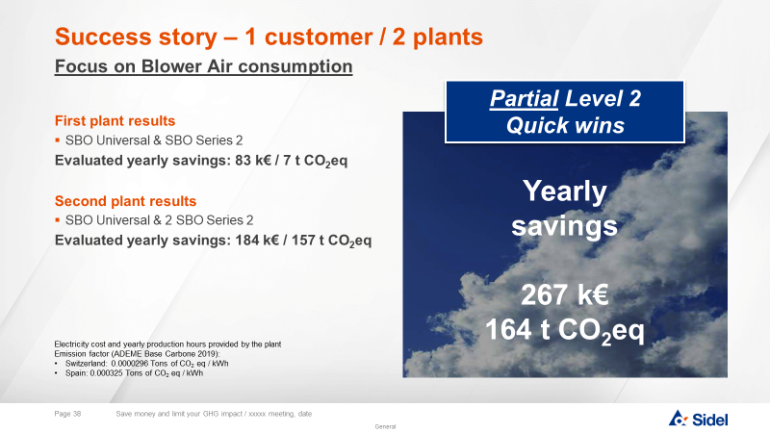

Eco-Audit Services – BLOWER
Sustainability
AU05-3 Eco-Partner
KEY FIGURES
Budget price
BENEFITS
DESCRITPION
Already some success stories
According to investment
AUDIT including QUICK WINS for fast payback
INSPECTION machine wearing, production quality
MEASUREMENT energy consumption per identified SKU, potential leakages
ANALYSIS
PROCESS OPTIMISATION to generate the first SAVINGS
and REPORTING with all IMPROVEMENTS POSSIBILITIES
IMPLEMENTATION of selected solutions
AUDIT to measure the real SAVINGS RELALIZED
On-site measurements to check bottle production performance and power consumption
Packaging assessment to identify optimization areas
Measurement analysis to identify optimisation levers
Equipment inspection to check overconsumption due to wear parts or non-optimized settings
Comparisons with original equipment specifications and ‘’Best in class’’ values from our databases
Process optimization of each SKU identified allowing decrease of energy consumption
Customer accompaniement to production tool (including packaging) transformation
Payback estimation
According to electricity price (could be less than 6 months)
Installation time
Not applicable
Machine downtime
Audit duration = 4 days incl. 1 full day production stoppage (+1 day per additionnal SKU)
Lower operating cost for lower environmental footprint
Can be combined with:
Diagnostic Visit
Packaging Process Intervention
DELIVERABLES
Lowest operating cost and environmental footprint
Machine application:
SBO Series 2
SBO Universal
SBO Matrix

