Slide 1
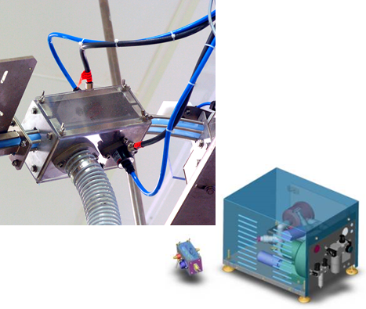
通过去除盖子上的灰尘来确保产品质量
帽式除尘装置
价值和益处
描述
Product quality
Increase the cleanness of the caps
Safety & Ergonomics
Low maintenance requirement
Reduce cleaning times
Felxibility
Applicable for all kind of plastic caps
Possibility to stop the line in case of cap dedusting stoppage (optional)
Ionized compressed air sprayed on both sides of the cap in a treatment box connected to a vacuum device.
Treatment box is install on the cap chute; technical box stays on the floor or on the top of the filler.
Compressed air filtration is at 0.01 microns, ionized air generator and vacuuming system enclosed in a stainless steel box (technical box)
价值： 产品品质
设备：GEBO Aidlin 和 GEBO OPTIFEED（包括竞争对手的设备）
产品目录代码：CAP001

