Slide 1
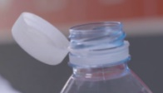

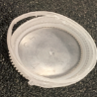
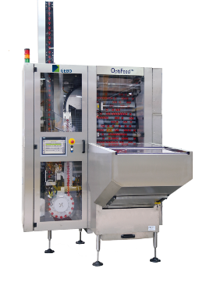
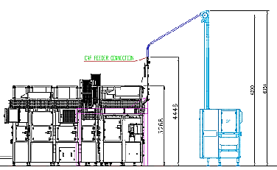
Free your mind on your closure feeding
OptiFeed® (plastic or crown caps)
Tethered caps Ready!
VALUE AND BENEFITS
DESCRIPTION
TCO
Efficiency achieved > 99,5%
Optimized MTTR
Optimized power consumption (no air)
Full access to all parts for maintenance & cleaning
Caps rejection w/o stopping caps flow
Smart HMI: maintenance pages, EIT interface, Vision pages
High flexibility & fast C/O
Product quality
Smooth cap orientation
Vision integrated preserving product quality & complete line performance
Sustainability & Hygiene
No air
Low power consumption
Waterfall cap orientation
Integrated suction unit
Estimate ROI < 3 years
Reduced footprint by up to 75%
Power consumption < 1,5 kW
Noise emission <80 dB
HMI 12”
Height < 2,1mt / remain up for transportation
Elevation up to 6,2 mt
Vision Camera integrated
L1: upside down & roundness & colour (option)
L2: +sealing ring integrity
> 150 OptiFeed ordered
4 on the crown declination
Radeberger SAT performed at 100% for the OptiFeed Cr during 3 days
Value: Efficiency, Product quality
Equipment: Sidel capfeeders
Catalogue code: CAP014

