Slide 1
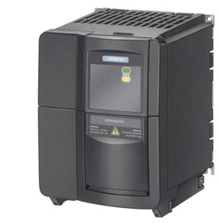
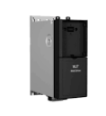
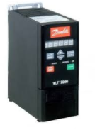
Anticipate spare parts shortage
5_84
New oven ventilation and preform elevator drive
VALUE AND BENEFITS
DESCRIPTION
Replacement of the oven ventilation and preform elevator drive by new one
Replacement of oven ventilation and preform elevator drive
The drives used for oven ventilation and preform elevator on your current Compact blower (Siemens Micromaster or Danfoss VLT2800) is not anymore available from the manufacturer..
The replacement solution include
a software modification
a wiring modification
new drives
Old drive generation
New drive generation
Value: Obsolescence,
Equipment: Compact Blower
Catalogue code: CB004

