Slide 1
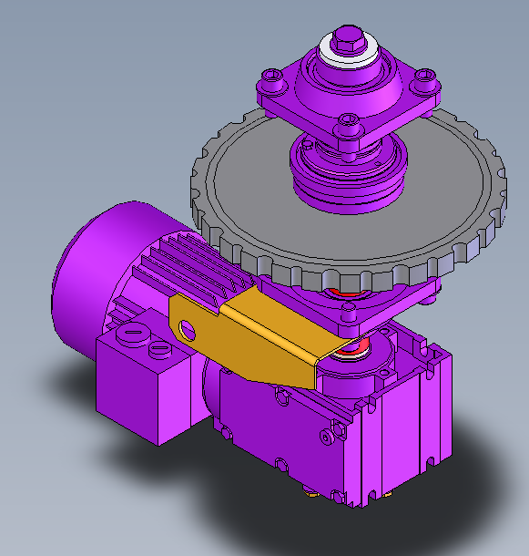
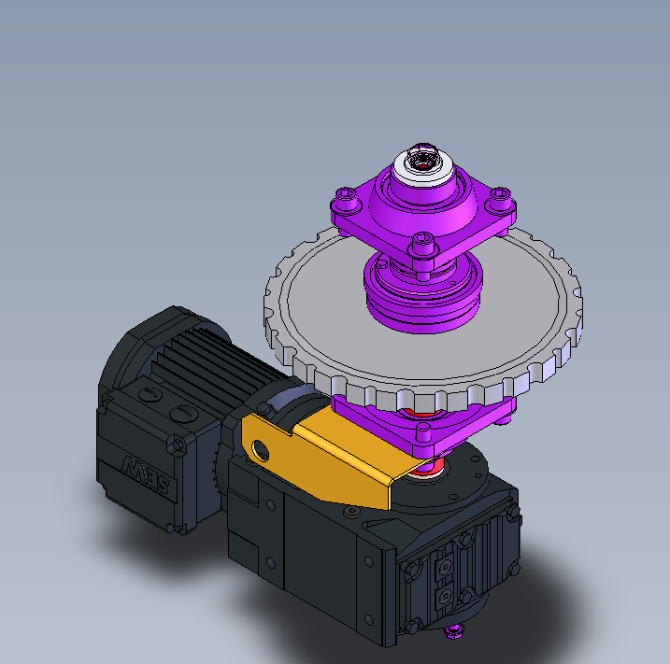
Maintain of production in the event of failure
5_84
New oven motor
VALUE AND BENEFITS
DESCRIPTION
Replacement of the oven motor and encoder by a new one
Replacement of oven motor
The oven motor used on Compact blower is not available anymore from the manufacturer..
Replacement solution include
New motor
New encoder
New mechanical support
New software update
Value: Obsolescence,
Equipment: Compact Blower
Catalogue code: CB005

