Slide 1
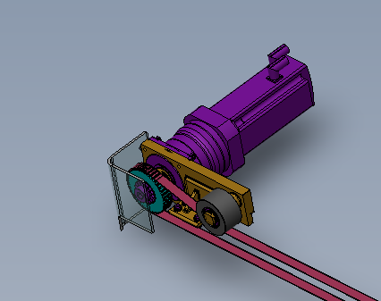
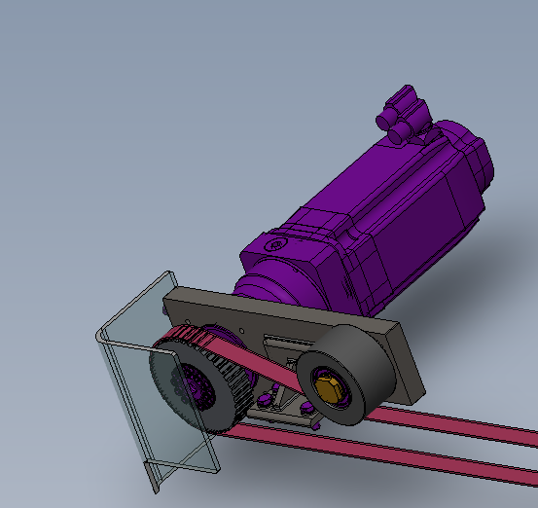
Anticipate the shortage of spare parts
5_84
New transfer motor
VALUE AND BENEFITS
DESCRIPTION
Replacement of the transfert motor by new one
- The transfer motor used on Compact blower is not available anymore from the manufacturer..
- Replacement solution include
New motor
New mechanical interface (pulley, motor support)
New software update
* This new motor works only with last generation of CPU. The retrofit CB001 Simotion CPU replacement may be mandatory as well to install this new motor
Value: Obsolescence,
Equipment: Compact Blower
Catalogue code: CB006

