Slide 1
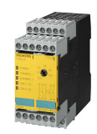
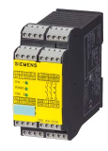
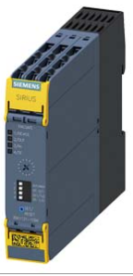
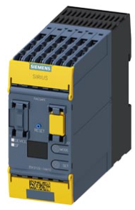
Anticipate the shortage of spare parts
5_84
New safety relays
VALUE AND BENEFITS
DESCRIPTION
Replacement of all safety relays by new ones
-The safety relays used on Compact blower are not available anymore from the manufacturer
Replacement solution include:
Doors safety relay and software
Emergency stop relay
Door Sensors or e-stop push button are still availables
Value: Obsolescence,
Equipment: Compact Blower
Catalogue code: CB007

