Slide 1
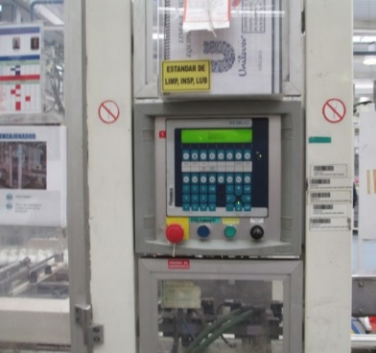
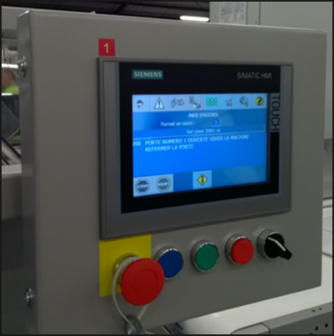
Update obsolete HMI with Siemens TP700
New display panel
VALUE AND BENEFITS
DESCRIPTION
Productivity
Secures the machine.
Always up to date
Latest generation material and available spare parts
Ergonomics optimization
Additional new functions available as an option
Replacement and installation to latest generation units with the same functionalities as the existing system
Before
After
Value: Obsolescence
Equipment: Packing Corcelles
Catalogue code: CLC-005

