Slide 1
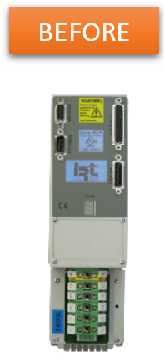
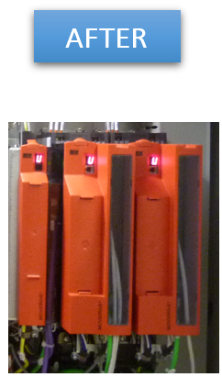
预计出现备件短缺
新型伺服变频器
价值和益处
描述
Latest generation material and available spare parts
Performance optimization
Increase in viability and productivity, avoids long downtime in case of breakage
Autonomy of maintenance staff
Increased memory capacity, enabling to handle extra sizes
Additional new functions available as an option (fine tuning)
Easier diagnosis for maintenance.
Supply new servo-inverter with Sew Movidrive Serie B
Replace motorization system, no longer compatible,
by Sew system.
价值： 增强维护，优化成本，提高效率
设备： All Packing type AN, ER 30, ER 60, SD before 2002, fitted with a numerical control Cyber or NUM 1040, IRT 1335, 1510, 1518, SEW Serie A, and Parvex motors
产品目录代码：CLC-016

