Slide 1
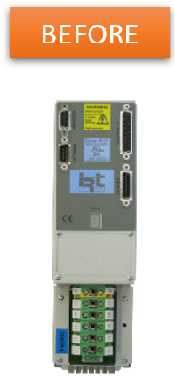
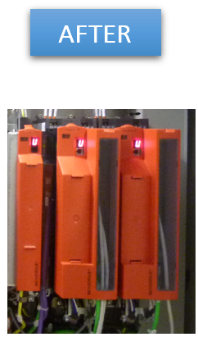
Anticipate spare parts shortage
New servo-inverter
VALUE AND BENEFITS
DESCRIPTION
Latest generation material and available spare parts
Performance optimization
Increase in viability and productivity, avoids long downtime in case of breakage
Autonomy of maintenance staff
Additional new functions available as an option (fine tuning)
Easier diagnosis for maintenance.
Supply new servo-inverter with Sew Movidrive Serie B.
Replace motorization system, no longer compatible,
by Sew system.
Value: Obsolescence, Cost optimization, Maintenance
Equipment: All Packing type AN, ER 30, ER 60, SD before 2002, fitted with a numerical control Cyber or NUM 1040, IRT 1335, 1510, 1518, SEW Serie A, and Parvex motors
Catalogue code: CLC-016

