Slide 1
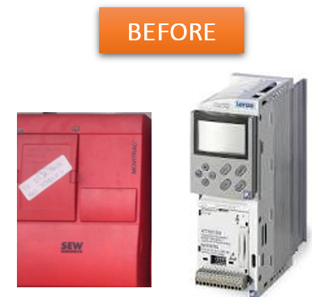
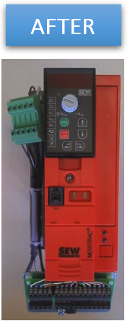
预计出现备件短缺
新型变频器
价值和益处
描述
Latest generation material and available spare parts
Performance optimization
Increase in viability and productivity, avoids long downtime in case of breakage
Autonomy of maintenance staff
Increased memory capacity, enabling to handle extra sizes
Additional new functions available as an option (fine tuning)
Easier diagnosis for maintenance.
Supply of new generation of frequency inverters with Sew Movitrac inverters, as per our standard
价值： 增强维护，优化成本，提高效率
设备： Packing machines and historical pelletizers
产品目录代码：CLC-017

