Slide 1
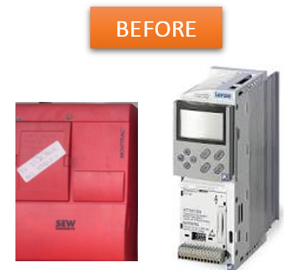
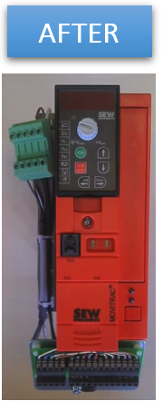
Anticipate spare parts shortage
New frequency inverter
VALUE AND BENEFITS
DESCRIPTION
Latest generation material and available spare parts
Performance optimization
Increase in viability and productivity, avoids long downtime in case of breakage
Autonomy of maintenance staff
Increased memory capacity, enabling to handle extra sizes
Additional new functions available as an option (fine tuning)
Easier diagnosis for maintenance.
Supply of new generation of frequency inverters with Sew Movitrac inverters, as per our standard
Value: Obsolescence, Cost optimization, Maintenance
Equipment: Packing machines and historical pelletizers
Catalogue code: CLC-017

