Slide 1



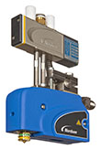
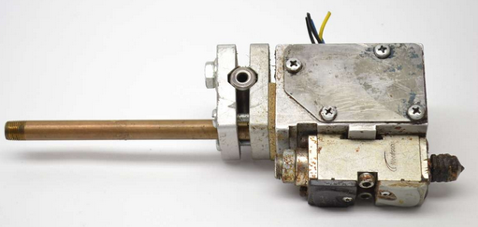
Secure your product quality and reduce TCO
Mini-Blue® Pack glue gun
VALUE AND BENEFITS
DESCRIPTION
Longer durability (2 or 3 times higher than the other pneumatic models).
Gun more precise than the classical guns, which means a reduction of 40% in glue consumption.
Reduction of 16% in the power consumption.
Reduced adhesive stringing.
Gun equipped with an insulating shell.
Reduction in burning risks (80° maxi)
Useable with all hot-melt glue types.
Connection on the current pipe.
Compact hot melt dispensing gun
The Mini-blue® guns uses the latest pneumatic technologies applied to glue guns.
Value: Sustainability, Cost optimization, Safety & Ergonomy, Product quality
Equipment: All Packing machines equipped with Classic™ and Solid-Blue® glue guns.
Catalogue code: CLC-023

