Slide 1
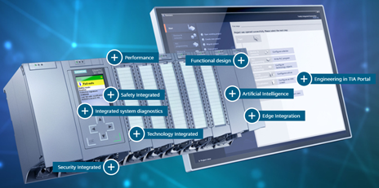
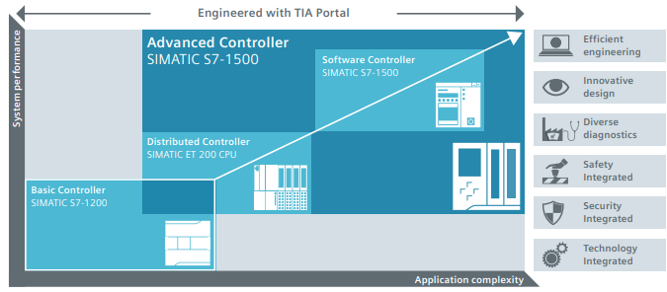
预计出现备件短缺
新 S7-1500 PLC
价值和益处
描述
Performance optimization.
Reliability and productivity increase.
Functional design, easy handling and maximum user-friendliness in many new details: integrated potential jumpers, shielding elements that can be mounted without tools, uniform front connectors, ergonomic terminal labelling.
Maintenance staff autonomy.
Increased memory capacity allowing additional format sizes.
New functionalities possible as options (adjustments more accurate, shorter response times, and command processing time up to 1ns in the CPU).
Diagnosis facilitated for the maintenance.
High safety & security level
Increase of the machine life cycle more than 50 000h
Supply of Siemens PLC S7-1500 of the latest technology.
Installed with Controller TIA Portal
license to buy directly by customer at Siemens
价值： 增强维护， 生产效率
设备： All Packing equipment ( Except Palletizer P4)
产品目录代码：CLC-055

