Slide 1
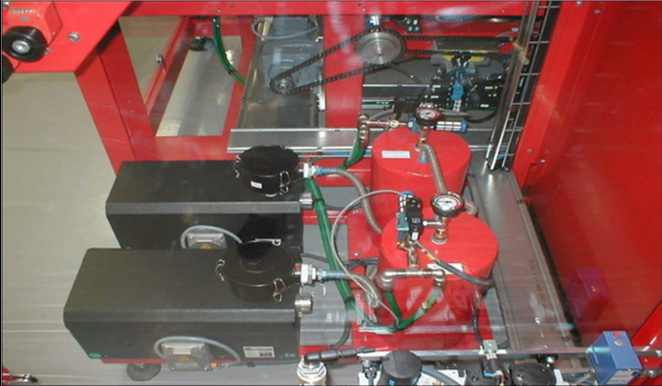
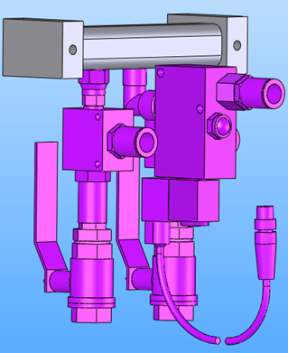
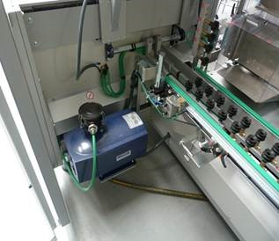
Save energy with Vacuum pump
Replace the Venturi system with new vacuum pump.
VALUE AND BENEFITS
DESCRIPTION
Savings
Reduces consumption of compressed air and energy
After 2 years: 1,450 €/year savings vs. Venturi solution
Any machine supplied with Venturi, type SB37 or other types (no. of pumps customized accoriding to machine speed)
After
Before
Value: Cost Optimization, Sustainability
Equipment: Packing Corcelles
Catalogue code: CLC-011

