Slide 1
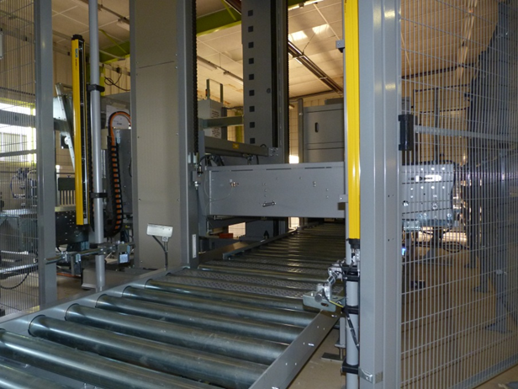
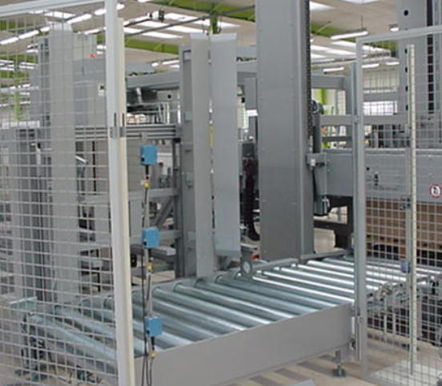
Enhance your equipment safety
Light safety barriers
VALUE AND BENEFITS
DESCRIPTION
Efficiency
reduced line stoppages to necessary ones
Safety
Comply with latest safety standards.
Any machine fitted with photocells can be upgraded with latest generation safety barriers (mainly palletizers).
After
Before
Value: Safety & Ergonomy, Obsolescence, Efficiency
Equipment: Packing Corcelles
Catalogue code: CLC-046

