Slide 1



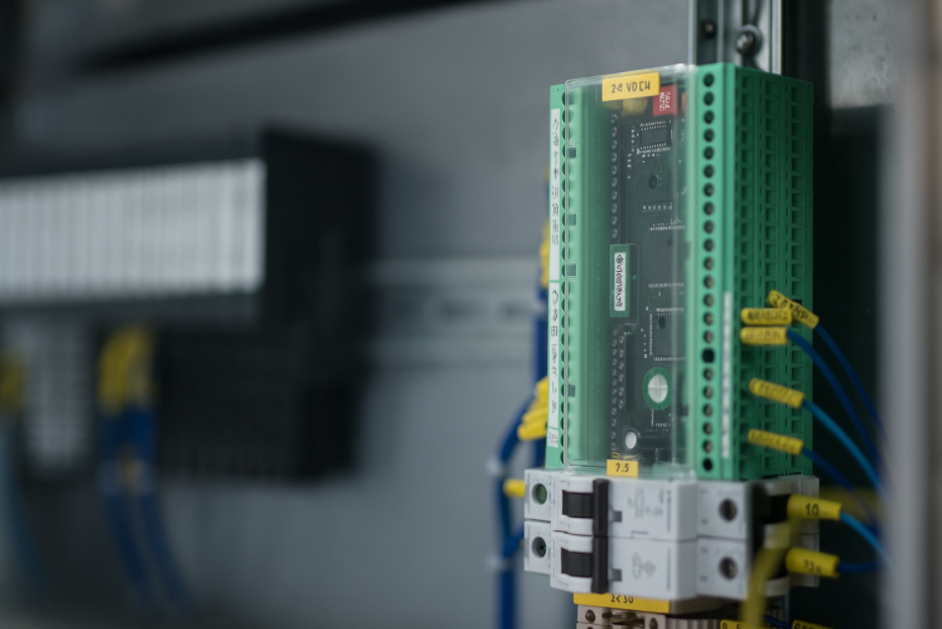
Gebo card replacement (obsolete)
EIC-016
KEY FIGURES
Prevent long downtimes in case of failure
Quick Payback
Spare Part Availability
BENEFITS
Gebo Card to replace
Spare Part Availability
Reduced Downtime Risk (10 weeks approximately)
Quick Payback
Short Installation Time
Improved Compatibility
Complete Upgrade Kit Provided
Installation time:
1 Day
Machine downtime:
DESCRITPION
1 Days
Retrofit kit designed to modernize bottling line equipment by replacing obsolete Gebo regulation cards
Average delivery time:
10 weeks
Machine application:
DELIVERABLES
Bottle Conveyors until 2015
Standardized hardware components
Updated electrical diagrams
PLC software upgrade
Functional testing on a selected SKU
Targeted sub assembly:
Bottle Conveyors - Inliners

