Slide 1
Upgrade to new standard and dynamic process control
FREQUENCY CONVERTER
VALUE AND BENEFITS
DESCRIPTION
Obsolescence
No risk of long stops of production in case of “Fault”.
Fine Speed regulations.
No need more PLC capacity thanks to the integrated smart logic controller.
Direct connection to PC thanks to the integrated USB port.
Efficiency
The inverter is designed to work with temperatures up to 50°C.
Sustainability
Save up to 60% of energy.
The frequency converter is designed to provide high shaft performance on electrical motors permitting a better “Inverter” management and preventive replacement of obsolete product. It comes in a standard version (FC 301) and an advanced high dynamic version (FC 302) with additional functionalities. It helps save energy, increase flexibility, reduce costs related to spare parts and servicing, and optimize process control on any industrial machine or production line
Value: Obsolescence, Efficiency, Sustainability
Equipment: Pal/Depal (PR)
Catalogue code: EOL-001-V01 FREQUENCY CONVERTER

Slide 2
Technical overview
TECHNICAL OVERVIEW
Ease of implementation | 1/3 (Complex)
Machine application exclusion? | Available for all the machines indicated in the Applicability Matrix
Mandatory option needed? | PLC version to be check
Targeted sub-assembly | Hardware existing version
Diagnostic visit and/or equipment refurbishment needed before upgrade? | No
Time to install upgrade | 1 days
Sidel expertise needed? | Yes.
Average delivery time | 4 weeks

Slide 3
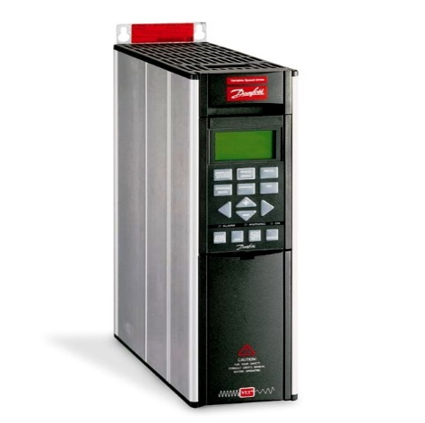
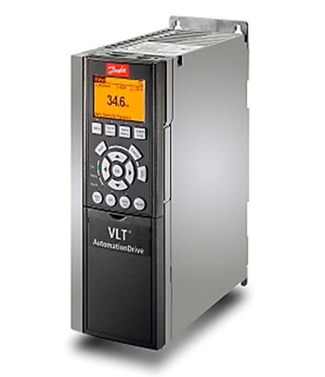
Technical description: Main principles
BEFORE
AFTER
VLT 5000
FC300/FC302
New solution:
Latest evolution with standard version and advanced high dynamic version
Save Energy
Reduced costs related to spare parts and servicing
Optimized process control
Current solution:
Obsolete features
Out of production
Difficult to supply

