Slide 1
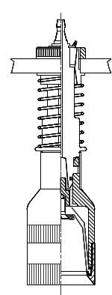
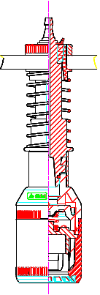
Reduce your maintenance cost and improve efficiency
Pneumatic Grippers
VALUE AND BENEFITS
DESCRIPTION
Maintenance
New pneumatic grippers improve lifetime of the device.
Are more resistant to impact.
Less maintenance.
Reduction in wear of the capping components.
Efficiency
Precise bottle grip and release
The old device has a pneumatic TPE membrane air activated by a compression on the bottleneck which
requires frequent replacements
With the new device there is no membrane installed but « Fingers » with a pneumatic/mechanical functioning.
The grip is on the bottleneck.
It is more resistant to impact with bottle.
Wide range grip diameter (ID= 35-42-48; OD= 52,5 - 58-65-72 mm).
Value: Maintenance, Efficiency
Equipment: Pal/Depal (PR)
Catalogue code: EOL-008

