Slide 1
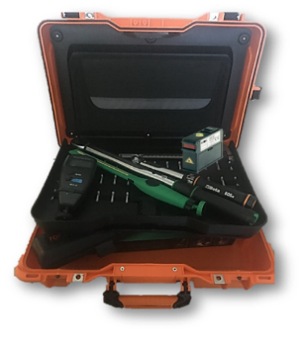
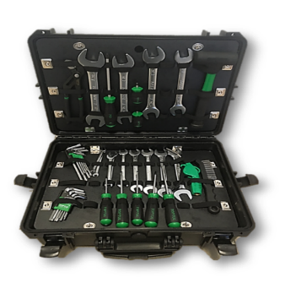
Drive your equipment maintenance at any time
Maintenance Tool Kit
VALUE AND BENEFITS
DESCRIPTION
Precise information on device adjustment (belt tensioning, levelling, tightening of bolts)
Devices driven maintenance accompanied by documents.
Precautionary efficiency before worn parts can generate damage or breakdowns
Availability of the right tool for each measure permit the exact control of the parts status.
Complete set dedicated with customized SOP & CILT.
More than 20 tools, including: Tension Meter; Laser Alignment Aid; Kit 6-32 mm of mechanical keys; SE 6" SAE and Metric; Electric Digital Caliber; Fix or adjustable size Caliber;
Dedicated instruction manual with the precise adjustment instructions
Available for all equipment installed from 2014
Value: Maintenance
Equipment: Pal/Depal (Pr)
Catalogue code: EOL-028

