Slide 1
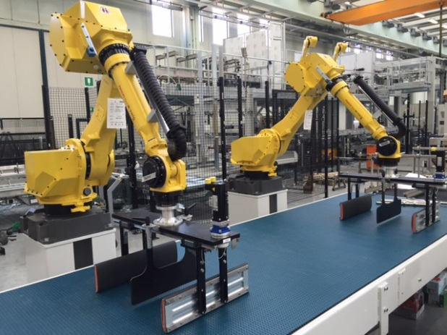
Improve your equipment efficiency
Robosmart Inlet for LINEAR / IBU
VALUE AND BENEFITS
DESCRIPTION
Productivity
Ensure higher productivity, precision, efficiency and packaging quality, further enhanced by the possibility to perform multiple pack grips in the same cycle.
Flexibility
Ideal for frequent format changeovers. Potentially unlimited number of palletization patterns can be created.
In case of new pattern is sufficient to install the software without needs of mechanical stoppers. Pack rotation without shocks. Less noise. Lower maintenance costs.
Quality
The flat top table ensures the packs stability during the layer preparation, especially for light weight packs.
ROBOSMART ™ Inlet is composed by a metering belt, a flat table top, robots (1 - 2 or more) for the layer formation and A flat chain table for the layer pushing station.
The robots gripping heads perform the layer pattern preparation (position and rotation).
ROBOSMART™ Inlet ensures precise and highly repeatable movement, with positive pack handling without shocks, also when the inlet packs are not perfect in quality
Value: Efficiency, Flexibility
Equipment: Pal/Depal
Catalogue code: EOL010

