Slide 1
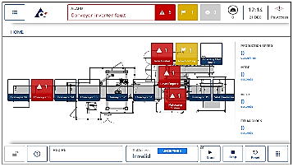

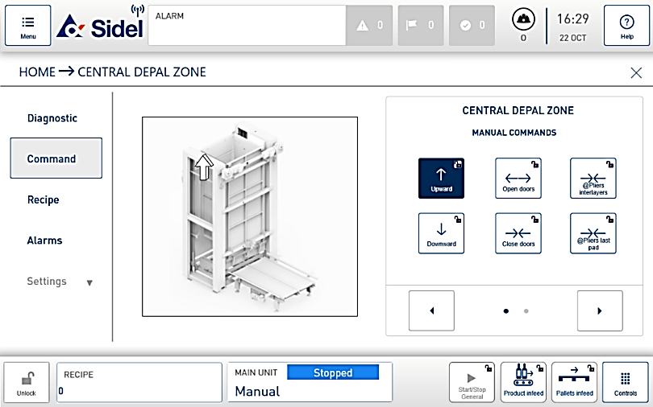
Increase equipment efficiency
SMART HMI
VALUE AND BENEFITS
DESCRIPTION
Efficiency
ADVANCED DIAGNOSTIC : Enable new diagnostic and interactive feedback features with direct link to SOP & CILT
ALARM LOCALIZATION : Identification of areas in fault.
ASSISTED RESTART : Quick way to restore jam at the inlet.
INTUITIVE CONTEXTUAL HELP :Explanation of each function with a simple command on the panel.
Smart HMI is a modular multi-touch interface designed for the operation of SIDEL machines. The user-centric application simplifies daily work with an easy-to-understand alarm and alarm system, contextual help and descriptions of descriptive and work processes. The HMI uses notifications and known operations from interaction with smartphones. All central parameters can be displayed quickly, via the header or in a more detailed synoptic view. Because the system supports all popular media formats, additional material (such as training videos or troubleshooting guides) can be made available through the HMI at any time.
“Smart Machine HMI” (Hardware and Software), enabler for :
Focus on operator for Improved User Experience
Industry 4.0, Internet of Things, Big Data
Value-added Applications and services
Modern look & feel, intuitive and user friendly
User-centric application simplifies daily work with an easy-to-understand alarm and alarm system
Notifications and known operations from interaction with smartphones
Value: Efficiency
Equipment: Pal/Depal
Catalogue code: EOL019

