Slide 1
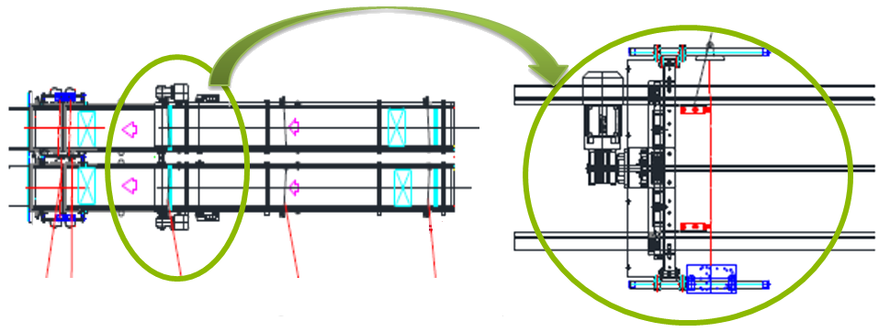
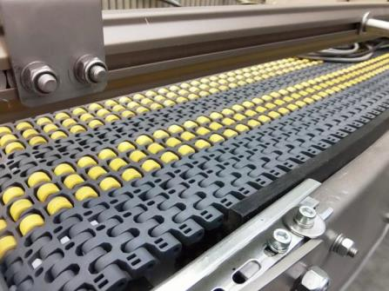
Less downtime and improved productivity
New accumulation conveyor
VALUE AND BENEFITS
DESCRIPTION
Maintenance
Higher resistance chain replaces the old rollers system.
Minimal friction and less pressure in accumulation.
Maintenance of conveyor extremely reduced and simplified.
Dosing guides will now be let loose avoid any risk of un-synchronized packs inlet.
Flexibility
Suitable for products with irregular or petaloid base.
Faster and repeatable guides adjustment (hand wheel system as standard or automatic as optional)
Productivity
Reduces dosing belt alarm frequency.
Greater functional reliability. System less sensible to packs quality and false stops. Silent operations
Inlet pack control is now moved from dosing belt into the accumulation conveyor. Safety “turned-pack” photocells are installed into the accumulation conveyor
Value: Efficiency, Maintenance
Equipment: Pal/Depal
Catalogue code: EOL022

