Slide 1
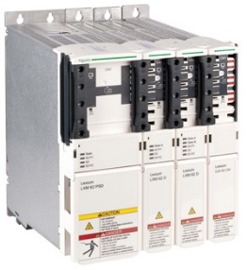
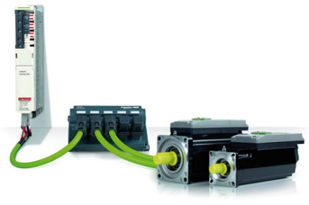
Keep the pace of electronics improvements
Pack Drive 3
VALUE AND BENEFITS
DESCRIPTION
Reliability
Reduces installation and wiring times during obsolete devices replacement
Reduces supply times
Semplification of electronic architecture
Higher machine reliability
HW lower costs
Improves machine processes
Simplified connections
Flexible safety solution
Touch panel and pads for the control
Maximising the energy and production efficiency
Allow you to synchronize up to 99 real servos (1ms cycle time) and up to 255 virtual axes
It allows transferring the software from one platform to another.
Compared to the M series, PacDrive3 has been enriched with numerous hardware and software innovations that have been developed in response to the functional requirements of the packaging industry, the entry level products of the LMC range allow to synchronize up to four and eight axes respectively. These are controllers designed for economical and at the same time scalable automation solutions.
A single programming tool, that is, a single program for complete machine management. Fully integrated Ethernet-based communication with SercosIII.Tool for the entire engineering, commissioning and diagnostic process included.
Value: Efficiency
Equipment: Pal/Depal
Catalogue code: EOL029

