Slide 1
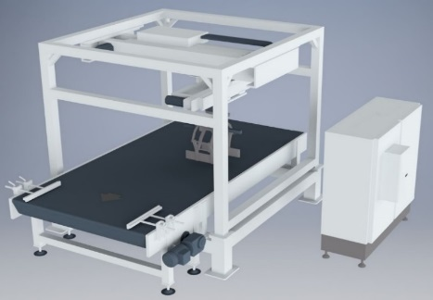
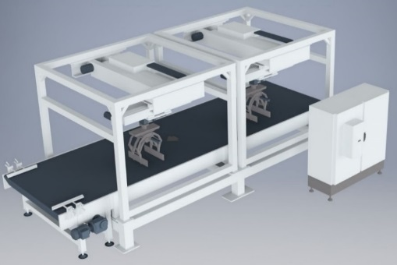
Gentle product handling for best efficiency
AXOSMART
VALUE AND BENEFITS
DESCRIPTION
Productivity
Ensure higher productivity, precision, efficiency and packaging quality, further enhanced by the possibility to perform multiple pack grips in the same cycle.
The device can handle all kinds of secondary packaging (cartons, packs and crates) with extreme precision
Ideal for handling more delicate packs/containers
Rapid format and palletizing pattern changeovers managed completely by software (with no manuals adjustments of mechanisms required)
Maintenance
Low maintenance required
The AXOSMART ™ 1 or 2 modules is the ideal equipment in term of installation space and inlet product handling upgrade.
It is composed by:
-One dosing conveyor that counts and separates products
-One transfer table made up of a mat of flat chains (for channeling and conveying the packs at the right speed
-One or more gripper heads – which transfer and turn the packs into the correct position.
-One layer forming table for positioning the packs according to the chosen palletization pattern.
Value: Efficiency, Flexibility
Equipment: Pal/Depal
Catalogue code: EOL031

