Slide 1
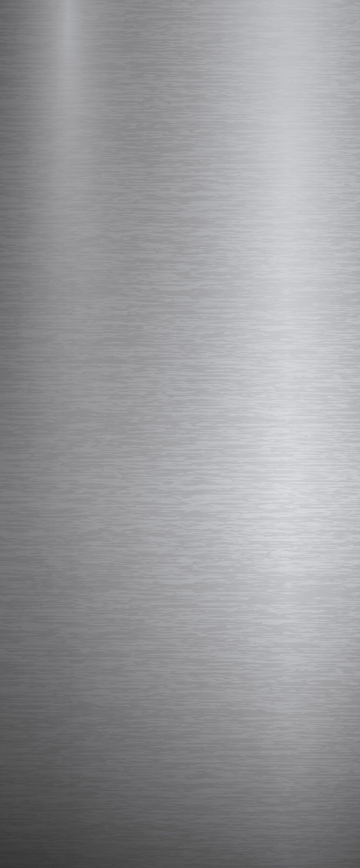


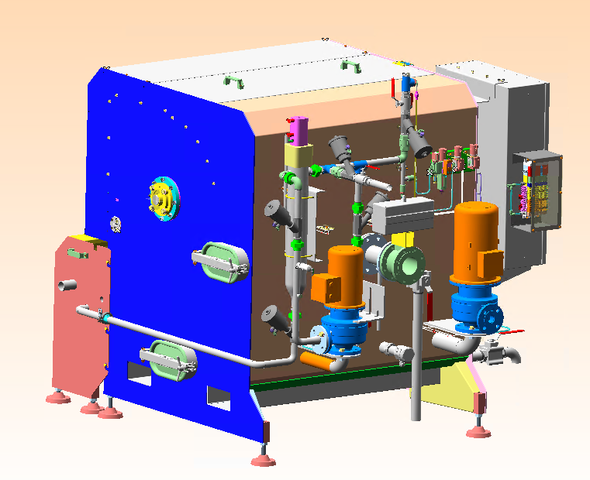
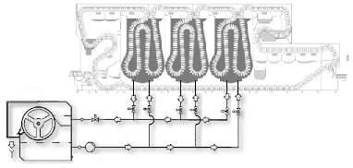
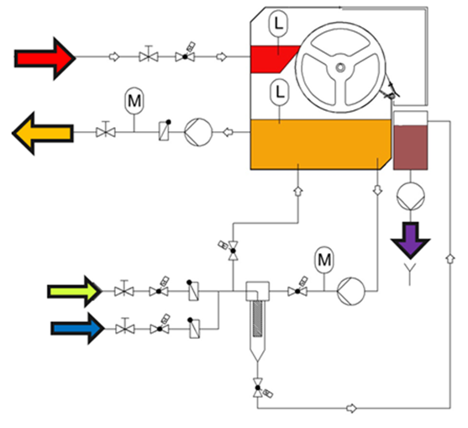
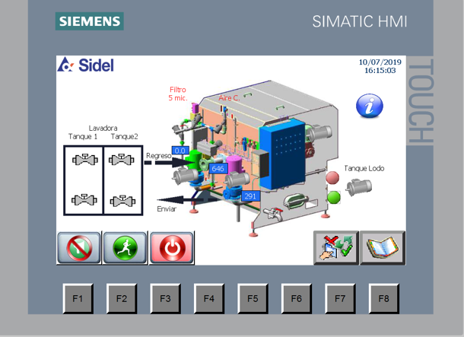
External caustic filter
Maintenance Product Quality
O&U ref VRB-021
KEY FIGURES
Budget price:
BENEFITS
DESCRITPION
Stand Alone Equipment
120k€*
Reduction of frequency of caustic soda solution replacement in the baths up t00%
Reduction of routine cleaning frequency of spraying unit and filtration unit up to 100%
Reduction of dirt remaining in suspension in the caustic soda baths for better quality of water in the rinse tanks
Reduction of risks of exposure to caustic soda solution during normal machine cleaning activities, no manual operation required during production
Reduced parts wearing
Installation of an external self cleaning filter to filter continuously the caustic solution of the detergent tanks removing dirt and solid particles up to 20µm diameter.
External installation of a new self cleaning filter unit, piping and automatic valves for BW connection
Designed for automatic filtration during production and out of production
Separate electrical cabinet with HMI for independent system (to be installed an all Sidel IB and competitors machines)
Payback estimation:
4 yrs
Installation time:
5 days
Machine downtime:
Applicable on competitors machines
3 days
*installation excluded
Can be combined with:
External Heating System
Machine application:
All Sidel Bottkewashers
Competitors bottlewashersl

