Slide 1



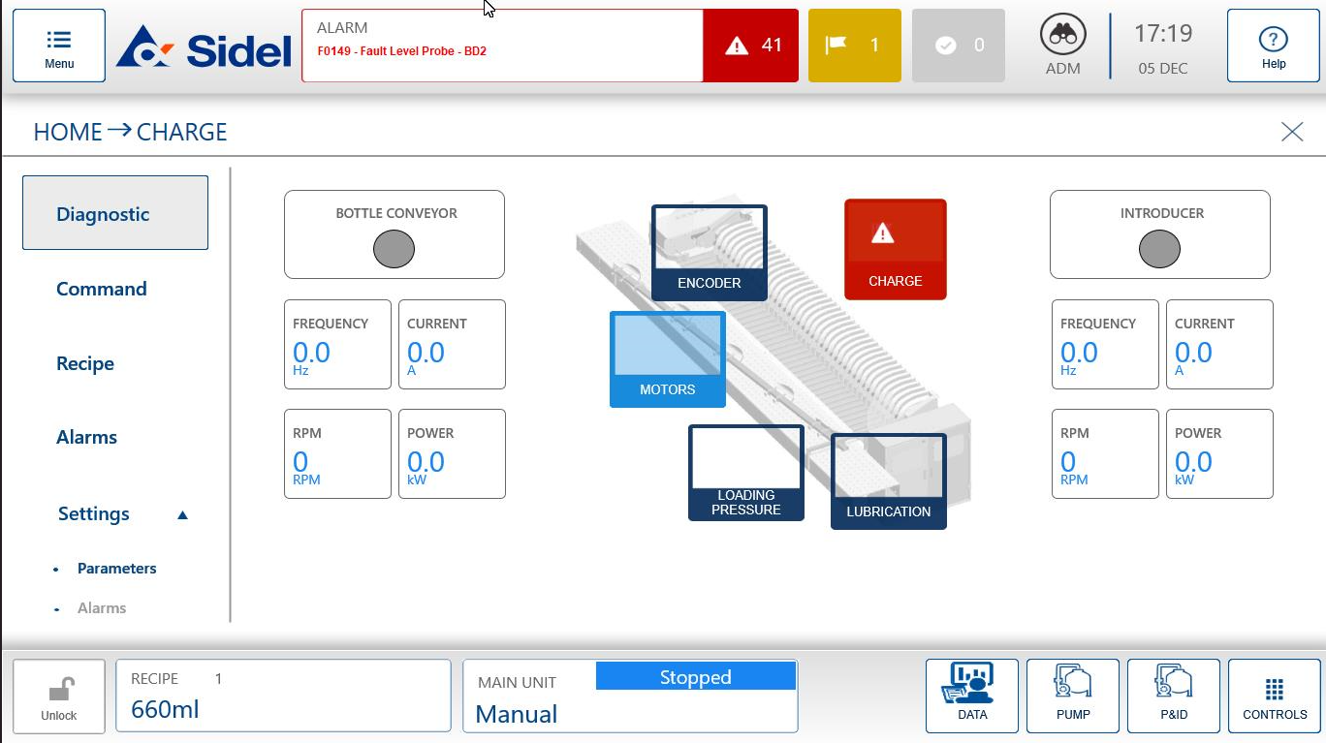
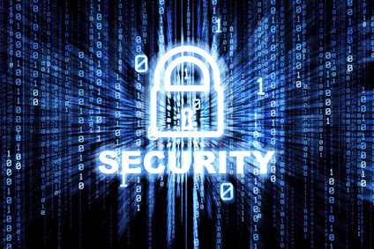
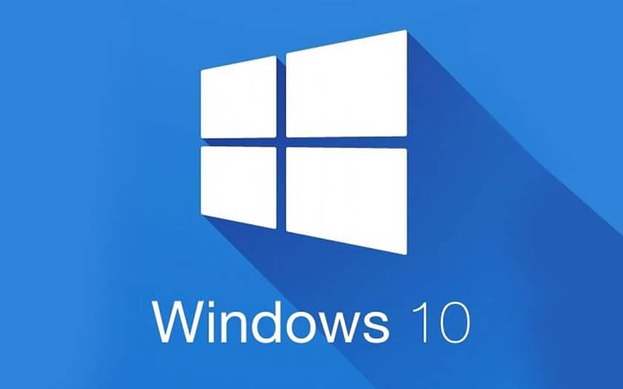
OPERATE YOUR BUSINESS SAFELY
Obsolescence
Cyber Security
Ref. VRB-XXX - HMI migration to Windows 10
KEY FIGURES
Budget price:
BENEFITS
DESCRIPTION
40-50k€**
Upgrading your HMI to Windows 10 is your best bet to stay safe from the ever-evolving threats from viruses.
System updates for a longer period
W10 force automatic updates
Excellent virus protection
Cyber Security & industrial control systems.
Prevents longer downtimes in case of failure
Depending on your current configuration, the proposed kit to migrate your HMI to W10 include:
New HMI
UPS+Battery
Ethernet switch.
eventually New CPU (depending on current configuration)
Zenon license and badge
Payback estimation:
Not applicable.
Installation time:
5 Man Days.*
Machine downtime:
2 days.*
*according to bottlewasher size and scope.
** Installation not included.
Can be combined with:
Machine application:
Sidel Bottlewashers

