Slide 1
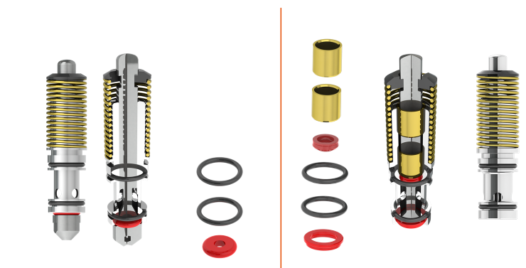
提高设备效率并降低维护成本
新的二氧化碳冲洗和减压按钮
价值和益处
描述
Wear reduction thanks to the slide bushes, and increase in productivity;
Increased tightness with new seals;
Longer life before maintenance/replacement for wear (up to 9000 hours).
The upgrade simply consists in replacing the previous buttons and rail with the following:
- New-generation CO2 flux and decompression buttons (with external spring).
- Dedicated flux rail.
- Dedicated decompression rail.
- Dedicated sanitation rail.
Solution actuelle
Nouvelle solution
价值： 效率，维护
设备： 灌装机 Eurostars REP, Eurostars REV, Starcans RSC, Starcans RAA, Starlight RBC
目录代码： HS049

