Slide 1
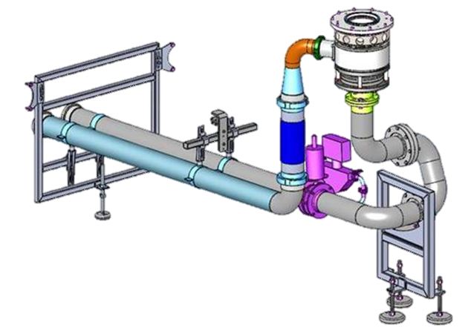
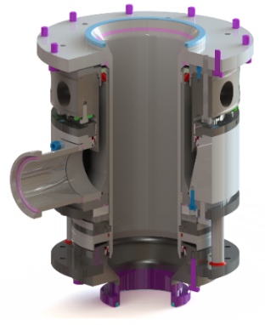
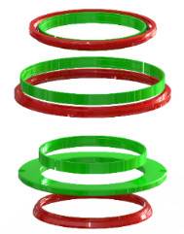
降低维护成本，确保产品质量
长寿命产品歧管
价值和益处
描述
Reduction of maintenance costs (every 6000h compare with 3000h currently)
Increase gaskets lifetime
Secure product quality – FDA conformity
New design of the lower manifold with new gaskets and sliding rings
the sliding seal has been replaced by a dedicated labyrinth.
To reduce the top load working on the manifold rotary union (RU), an additional supporting unit has been introduced to unload the weight of the full piping
价值： 维护，效率, 产品质量
设备： 填料 SRMC (SF100)
目录代码： HS120

