Slide 1
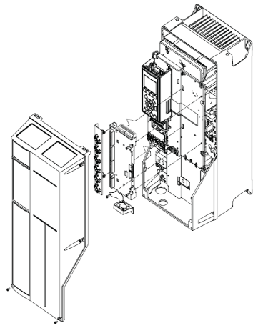
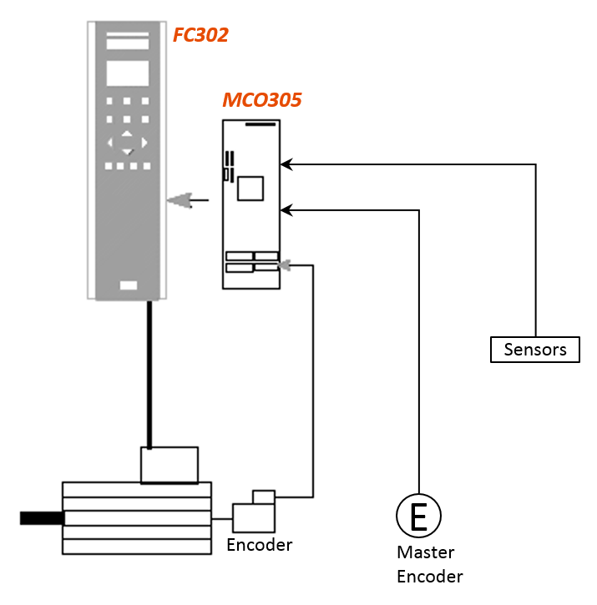
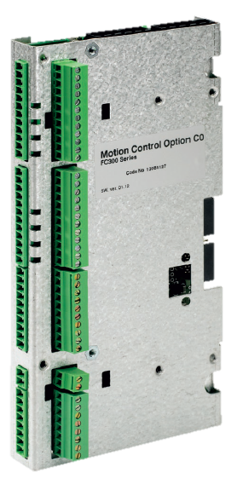
Anticipate spare parts shortage and reduce maintenance costs
New Frequency Inverter and Cleverax Card
Value and benefits
Description
Safer solution with newer component available in the market.
Can prevent long downtimes in case of failure
  CleverAx Synchronization card installed on Several Combis production is stopped by manufacturer as well as the Converter VLT5000 series.
  Risk of imminent Spare Part unavailability.
  Risk of long Downtime for equipment at Bottlers prod plants.
Added Profibus control to the Frequency converter (compared to the versions in which it was missing)
  New system with Danfoss FC302:
    The new system consists of Danfoss FC302 converter with the new MCO305 card embedded.
    The MCO305 controller extends the frequency converter functions for synchronization application.
    To be evaluated case by case the need of PLC module replcm.
FC302
MCO305 card
Value: Obsolescence, Maintenance
Equipment: All the COMBI Fillers with electrical management of the filler-blower synchronism
Catalogue code: HS122

