Slide 1
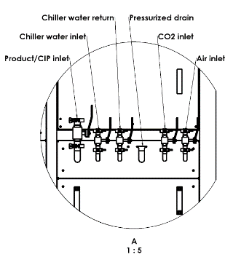
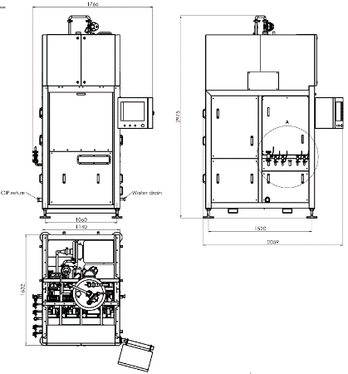
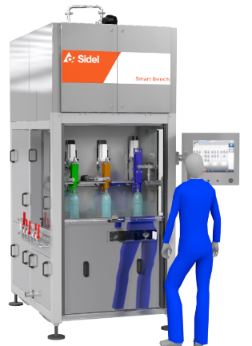
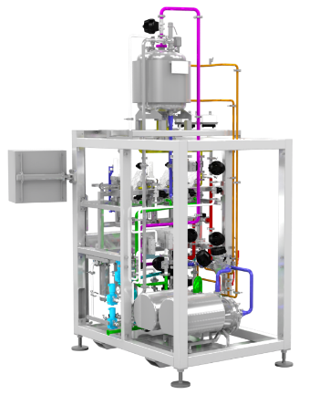
Reduce maintenance cost and secure equipment efficiency
SF300 & SF100 Valves Test Bench
VALUE AND BENEFITS
DESCRIPTION
Filling Valves maintenance and check without machine downtime;
Possibility to test three different valves (not in the same time).
Test bench made of stainless steel frame, frontal access panel in LEXAN, removable panels in stainless steel, easy access to the work area.
This bench allows quick and fast removal of the tested filling valves, comfortable access for maintenance and has fast connections to pipe circuits by means of clamps.
Connections
Overall Dimensions
Test Bench Front and Rear View.
Value: Maintenance, Efficiency
Equipment: SRMB (SF300), SRMC (SF100)
Catalogue code: HS125

