Slide 1
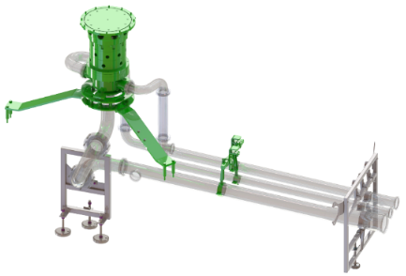
Reduce your maintenance cost and secure equipment efficiency
New lower Manifold
VALUE AND BENEFITS
DESCRIPTION
Seal durability of 6000h instead of 3000h currently
Reduced product seal wear
Increased efficiency by reducing maintenance stops
Secure product quality
The new design of the lower manifold allows a reduction in the maintenance time interval and less machine downtime; the gaskets durability is increased.
Less components to be replaced during the maintenance intervention
To reduce the forces working on the manifold rotary union, an additional support unit has been defined to unload the weight of the full piping. To be checked the dismantling tools available in the customer plant.
Value: Maintenance, Efficiency
Equipment: SRMB (SF300), Eurotronica FM-C RVE, Starcans HS RSC, Starcans FM RSE, Eurostar HS REP/REV, Eurostar RPN/RPS/RPT
Catalogue code: HS126

