Slide 1
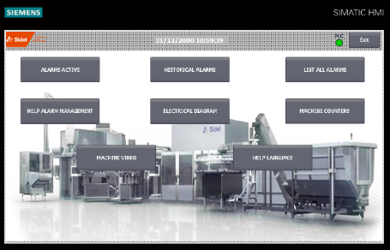
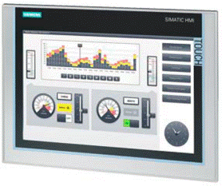
Increase your equipment efficiency
Fillers HMI Alarm Management
VALUE AND BENEFITS
DESCRIPTION
Improve diagnosis during machine stoppage to take corrective action for OEE improvement;
Improve technical diagnostic on the machine;
Reduce the operator training cost;
Share company competence and engage a TPM development.
To reduce the time for passing informations between the operators during the shift change, a new management of the alarms has been implemented on the operator panel. The new HMI alarm management is independent from the current HMI.
The new HMI mainly has in addition: the alarms historical data, the alarms OPL (that allows operator to know how reacting to the alarms) and the counters (that take into account the difference between the production hours and running hours).
1
MACHINE COUNTER
5
2
SMART SERVER
ALARM LOG
4
3
VIDEO USEFUL PROCEDURE
ALARM INDEX
Value: Efficiency, Maintenance
Equipment: Fillers RAA-RAC-RAD-RAE-RAF-RAG-RBC-RBS-RBV-REE-REG-REP-REV-RFD-RFE-RFI-RJT-RNF-RPI-RPN-RPS-RPT-RSC-RSE-RVE-RVH-RVI-RVL-RVS-RVT.
Catalogue code: HS127

