Slide 1
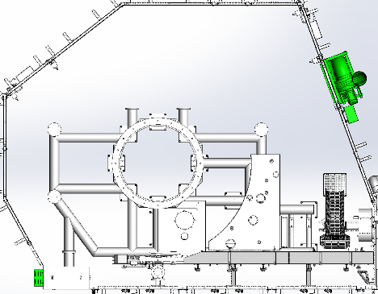
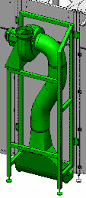



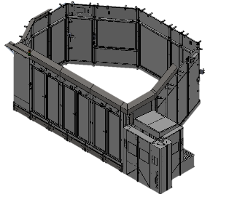
提高操作员安全性
二氧化碳提取系统
价值和益处
描述
CO2 concentration drastically reduced (no alarm);
Extraction of CO2 at floor level;
Large opening extraction blade;
Safe and ergonomic device;
Safer environment for operators.
The new system basically includes two components: CO2 extraction group and CO2 detector (in two points of detection). In order to extract the CO2 from the filler more effectively, it is foreseen to contain it with plastic guards: these will separate the filler from the space outside the protection doors, in the area shown in the figure below in yellow (at floor level).
It must be verified if the machine is already equipped with the closing plastic guards, otherwise they must be provided for the application of the upgrade.
Example of layout for a cans filler
Extraction point
CO₂ Detector
Plastic guards area in a cans filler
CO₂ Detector
(first point)
CO₂ Detector (second point)
价值： 改善安全和人体工学性
设备： 灌装机 RAF-RBS-RBV-REE-REG-REP-REV-RFD-RNF-RSC-RSE-RVE-RMA(SF320)-RMB(SF300)-RME(SF330)
目录代码： HS128

