Slide 1
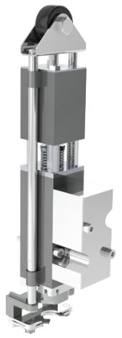
降低维护成本并确保设备效率
RVE充液阀2.0
价值和益处
描述
New roller layout increase lifetime + 100%;
New pneumatic kit does not produce abrasive dust;
New columns bushings self-lubricants;
New membrane group FDA fully certified;
New rubber mouth transfer aroma free;
New gripper with lower maintenance costs.
Complete overhaul kit for Eurotronica FM-C RVE valves, using innovative material to improve the duration of the seals, improving the hygiene and reduce the maintenance in most areas subject to wear and stress.
This upgrade consists of a kit that basically includes six components: New Roller & Quick Change System, New Pneumatic Kit, New Columns Bushings Kit, New Membrane Group, New Rubber Mouth, New Gripper.
Example of current RVE filling valve
Example of new RVE filling valve
价值： 维护，效率
设备： 灌装机 Eurotronica FM-C SRVE
目录代码： HS129

