Slide 1
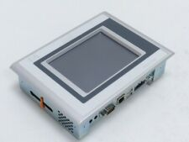
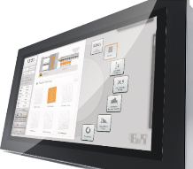
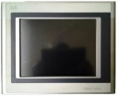
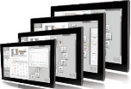
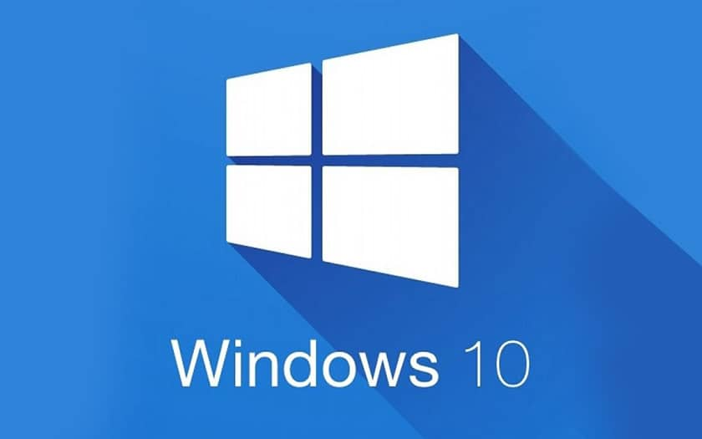
安全操作设备
HMI迁移到Windows 10
价值和益处
描述
Prevents longer downtimes in case of failure ;
Enhanced cybersecurity features available thanks to W10 ;
20% faster on system booting and touch operations ;
Improved image quality ;
Improved heat resistance ;
Increases performance and reduces maintenance cost
It’s time to upgrade to Windows 10!
The new system with B&R 3100 HMI panel, Windows 10 based, consists of a new plug & play HMI with the same screen size based on Windows 10. It includes software backup encryption and porting from existing platform (WCE, W7…) to W10.
No changes will be applied to the graphics layout, will be performed only a conversion. It includes hardware material and the Installation Procedures document. If a client-server function is present, the Counterpart’s panel must also be updated.
Example of current panels PC
PPC120
PPC320
PPC900
PPC3100
价值： 更新换代, 效率, 成本优化
设备：所有机械填充物
产品目录代码：HS130

