Slide 1



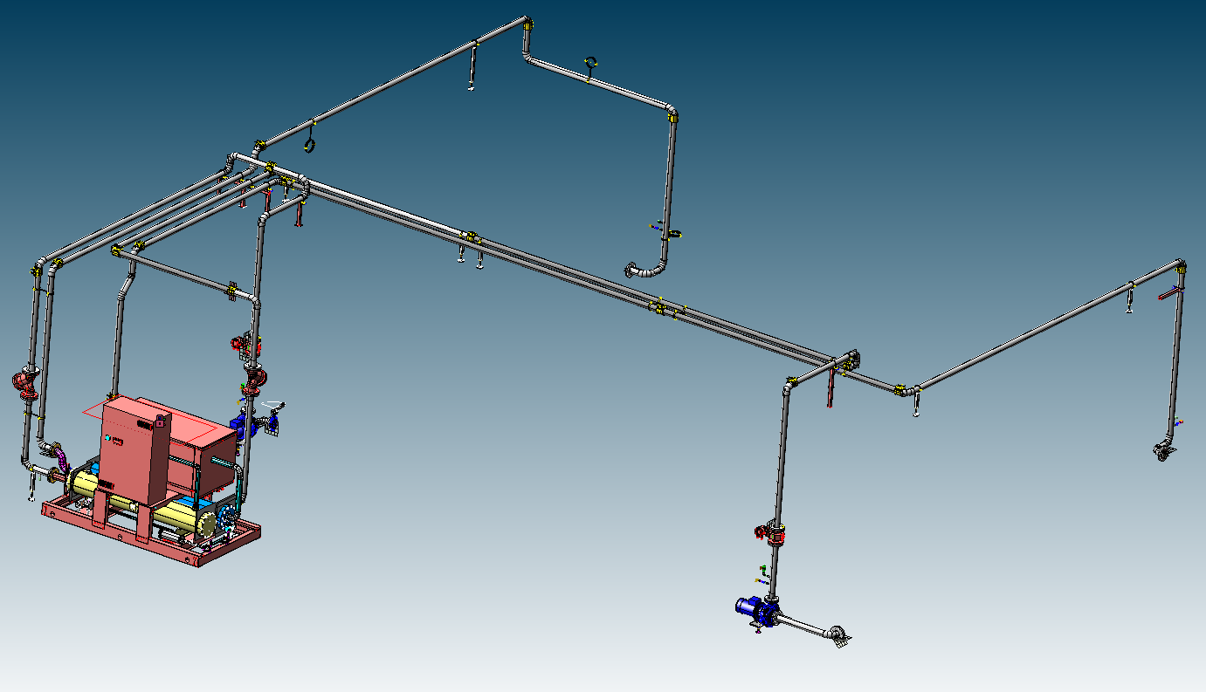
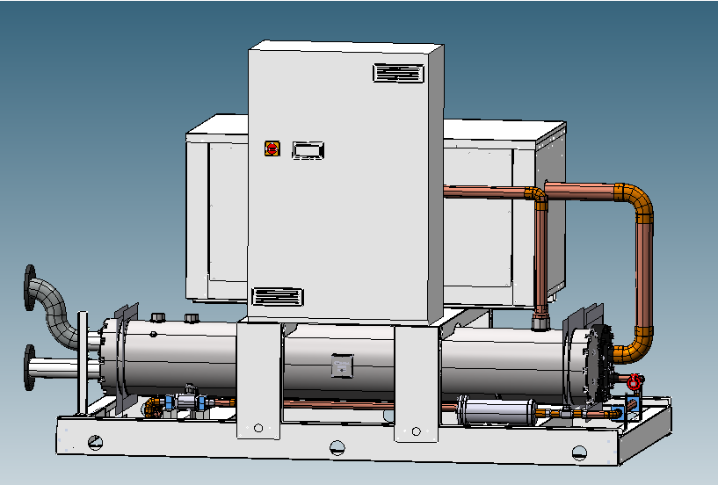
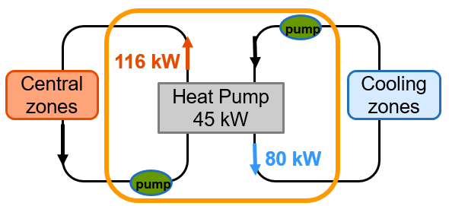
Heat Pumps on pasteurizers
Sustainability
Energy Saving
O&U Ref – VRP-030
KEY FIGURES
Budget price:
BENEFITS
DESCRIPTION
Easy to install
250k€*
Energy saving: Optimized energy management recovering heating calories from cooling process.
Reduced carbon footprint: Reduce the usage of steam/SHW (gas) for heating purpose
Water saving removing heat from the cooling phase
Lower TCO: Thanks to lower energy and water consumption (less 25% steam and 50% water)
Application of heat pump on a single machine transferring heat power from cooling to heating phase.
Installation of an external heat pump skid connected with a double piping circuit to the cooling side and to the heating side of the pasteurizer
Software and electrical modification to manage the system directly by the pasteurizer HMI.
Installation can be done off line, the line can be stopped only two days for the last connection phase.
Payback estimation:
3 yrs
Installation time:
6 days
Machine downtime:
Installation off line
3 days
*installation excluded
Can be combined with:
Prince E
Machine application:
All Sidel pasteurizers
Competitors machines

