Slide 1



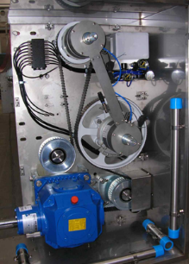
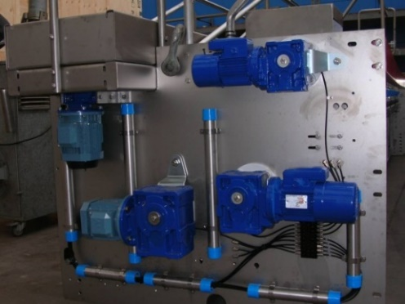
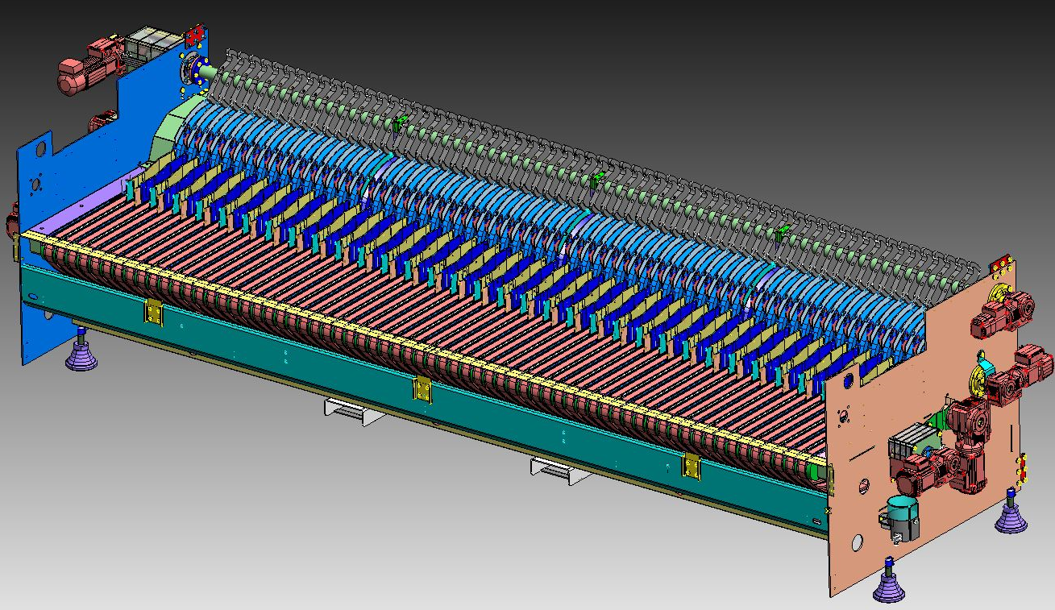
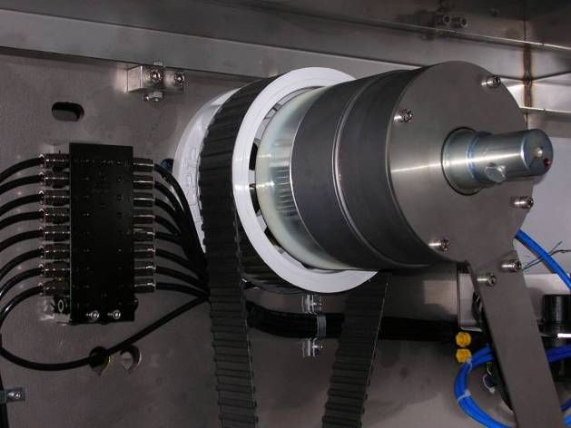
High speed infeed system
Maintenance Efficiency
O&U ref VRB-013
KEY FIGURES
Budget price:
BENEFITS
DESCRITPION
Easy adjustment and synchronization
200k€*
Reduction of maintenance cost (spare parts+ intervention) up to 60%
Automatic safety restoring, shortening recovery times and increasing efficiency up to 0,3%
Easy synchronization
Protection against overloads by pneumatic torque limiters
Easy maintenance operation.
Reduced parts wearing
Replacement of loading unit with a simpler new model and with less wear parts
The system also includes a pneumatic safety system on both main shafts
The position is restored by the action of dedicated gearmotors
The conveyor belts feeding the bottles to the inserter fingers are operated by gearmotor with inverter.
Load shafts drive by means of toothed belt
Payback estimation:
4 yrs
Installation time:
6 days
Machine downtime:
Automatic position recovery
4 days
*installation excluded
Can be combined with:
New HMI windows 10
Machine application:
All Sidel Bottkewashers
Competitors bottlewashersl

