Slide 1



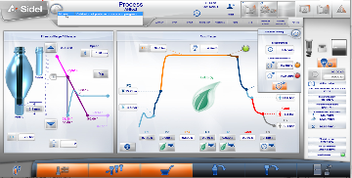
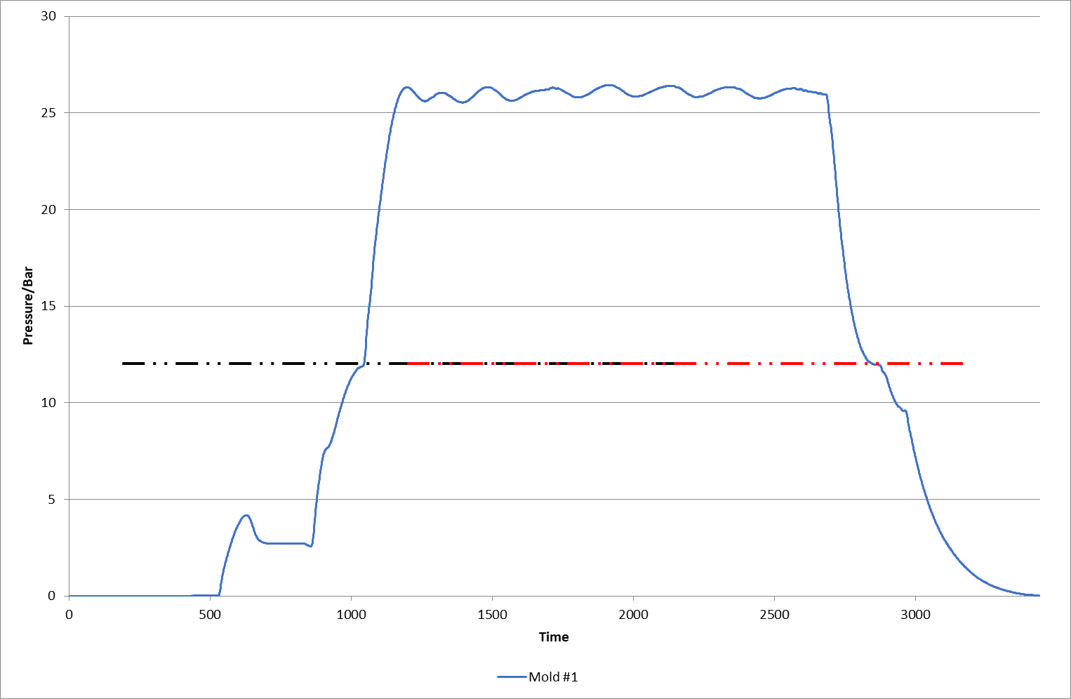
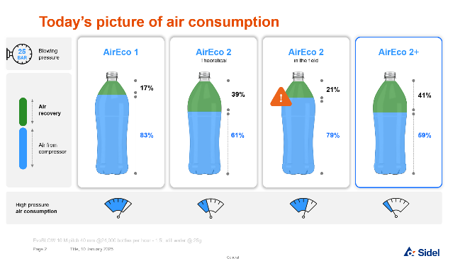
AirEco2+
Sustainability
O&U reference 2088
KEY FIGURES
Budget price:
BENEFITS
DESCRIPTION
30 000 €* installation included
Reduce your operating cost and environmental footprint with no compromise
Maximize air recovery (AirEco2) efficiency so reduce air consumption
User friendly and ergonomic system
Intelligent and responsive air recovery system
Flexible setting without compromising packaging quality
Opportunities for blowing pressure reduction thanks to optimized blowing process and Process intervention
Advanced software for optimizing blowing curve
Prevents operator unproper timing setting and secure optimized air consumption
Optimized blowing time
Process intervention to secure bottle quality and optimize air consumption
Payback estimation <2years
According to electricity price and air flow
Optimised settings
Installation time:
4 Days**
Machine downtime:
1 Day (1 production shift)
* including 2 SKUs.
** Including 3 days for process on 2 SKUs
Real customer case
Air savings | -22% ⁽¹⁾
GHG emission reduction | -22 t CO₂ eq ⁽²⁾
Payback | 1,6 year ⁽³⁾
Can be combined with:
Eco-Value audit for blower [AU05-2]
AirEco2 [2015]
Machine application:
Savings linked to recipe settings optimisation and process adjustment
4500 h production time – SBO 14 Matrix running at 33 600 B/h - GHG conversion factor = 0,278 kgCO₂/kWh - EUROPE28 // TERNA 2019
4500 h production time – SBO 14 Matrix running at 33 600 B/h - Electricity price = 0,2 €/kWh Average EUROPE // https://www.globalpetrolprices.com/electricity_prices/ // March 2024
EvoBLOW regular equipped with AirEco2

