Slide 1




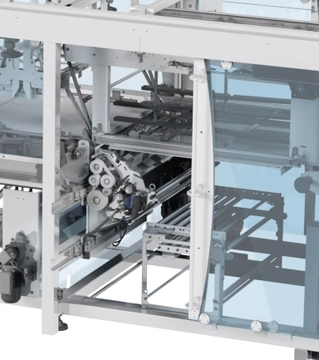
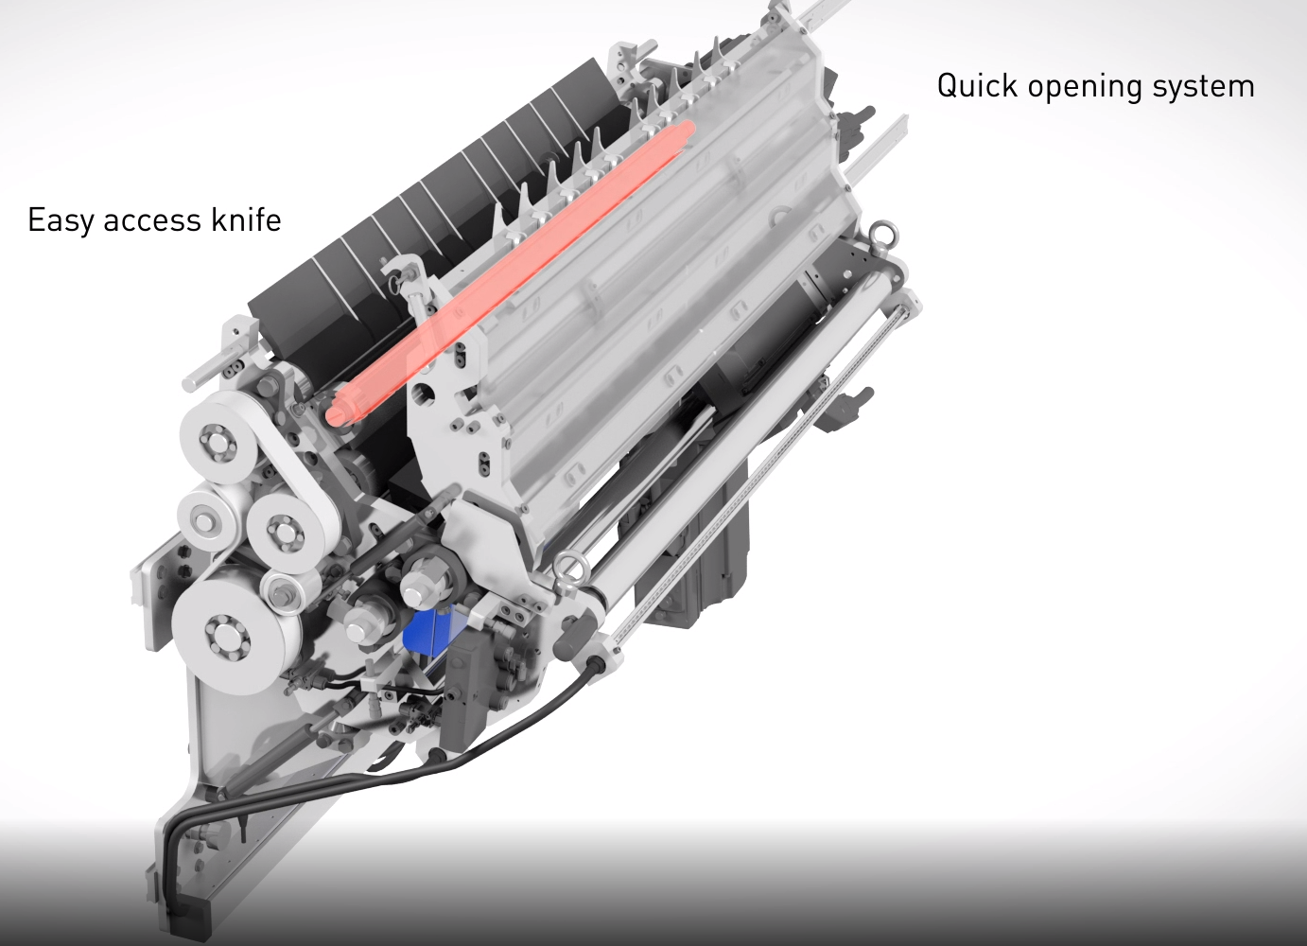
NEW FILM CUTTING UNIT
EFFICIENCY
Ref. LSX-002
KEY FIGURES
Budget price:
BENEFITS
DESCRIPTION
45K€*
Film Tickness: from 27 to 100 microns allowing potential reduction. Automatic adaptation.
The solution for use bio-sourced film or 100% recycled & recyclable film.
Much greater tolerance with respect to variations in key films characteirstics.
Output rate acceleration:+10%
Improved access to all elements. 30% savings on maintenance cost and fewer wear parts.
Reduce your raw material consumption.
Reduce your cost energy consumption
Complete extractible module.
No adjustment needed. Settings made only once.
Easy & secure access to the Knife
Quick changeover of rollers.
Saving example:
TSP– 40K bph – 5000h/year
25.000 Kw/h saved per year
3.750 € saved per year (electricity)
18 tons film saved per year
27.000 € saved per year (film)
32.000 € saved per year (film + electricity + labour)
Payback estimation:
32 000 € saved per year
Installation time:
5 Men Days*
Machine downtime:
2-3 days line shut down
*installation included.
Can be combined with:
N.A
Machine application:
Versa Combi,
ShrinkWrapper,
Versa Film,
Generic, Packer Wrap Around.

