Slide 1
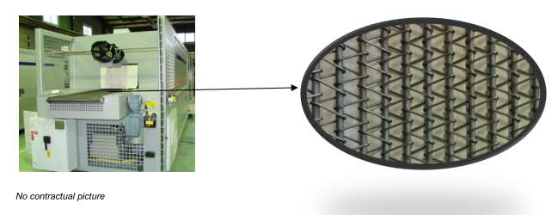
KIT OF ECONOMIC TUNNEL’S BELT
SUSTAINABILITY
Ref. LSX-018
KEY FIGURES
Budget price:
BENEFITS
DESCRIPTION
15k€*
Energy saving due to the 15% earning on the weight of the belt.
Can be easily changed during a tunnel maintenance.
No constrain of important modification.
Reduce your cost energy consumption
Replacement of the current metallic belt by a lightweight metallic belt.
Applying instead of current belt.
Kit including drive shafts, chain guides and belt guides
Examples:
VERSAFILM®VF3ST3–40K bph – 5000h/year
50.000 Kw/h saved per year
7500€ saved per year
Payback estimation:
7 500€ saved per year
Installation time:
2 Men Days
Machine downtime:
3 days line shut down
*installation included.
Can be combined with:
TBD
Machine application:
Versa Combi,
ShrinkWrapper,
Versa Film,
Generic, Packer Wrap Around.

