Slide 1



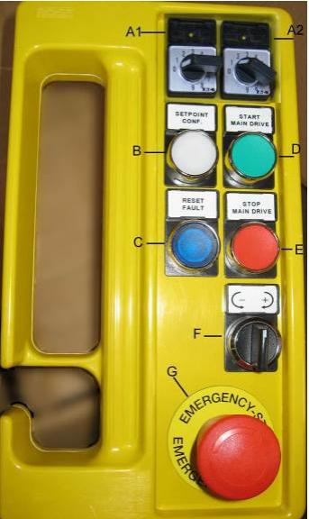
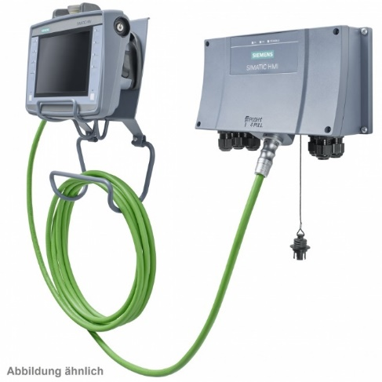
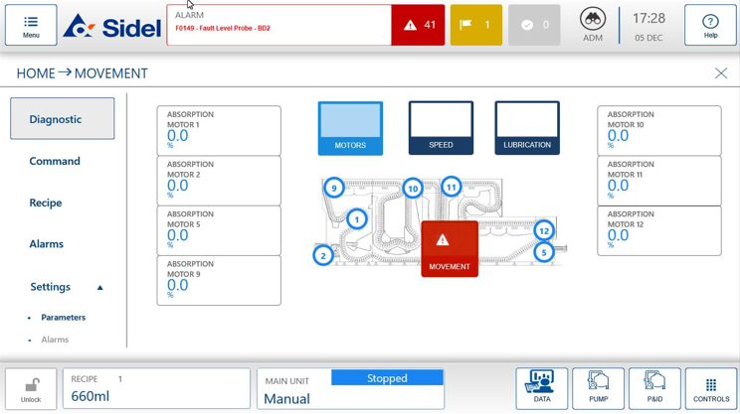
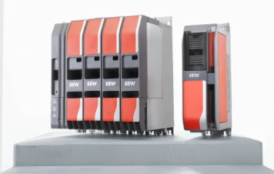
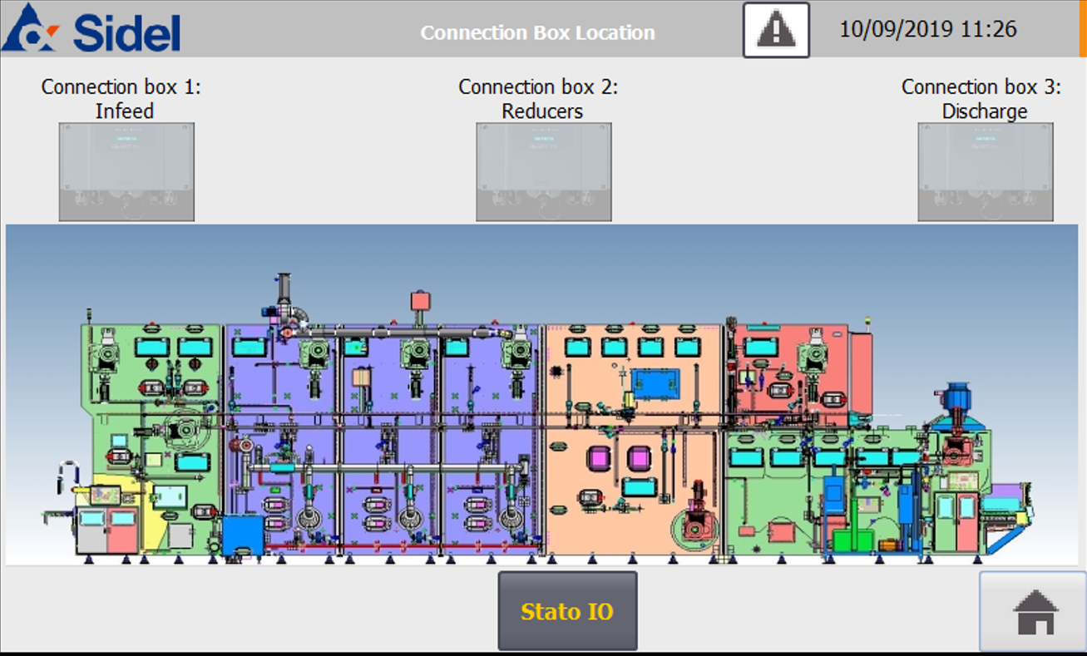
Operate your business safely
Obsolescence
Safety/Ergonomics
Ref. VRB-057 – MoviDrive C for Electronic Axis
KEY FIGURES
Budget price:
BENEFITS
DESCRIPTION
90-100k€**
Improved diagnostic support
Synchronization adjustment directly from the jog Panel
Compact frequency converters
Improved energy management
Possibility to make diagnostic directly from the mobile panel
Touch panel for easy operation
Replace the obsolete MoviDrive B system (frequency converters, PLC and encoders)
Replace the main motors
Installation of Software modification
Replace of the old Jog push button with touch panel
Payback estimation:
Not applicable.
Installation time:
6 Man Days.*
Machine downtime:
4 days.*
*according to bottlewasher size and scope.
** Installation not included.
Can be combined with:
HMI upgrade to windows 10
Machine application:
Sidel Bottlewashers with electronic axis

