Slide 1



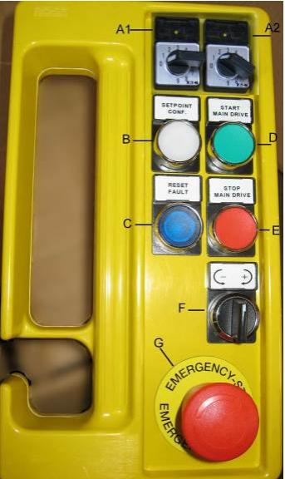
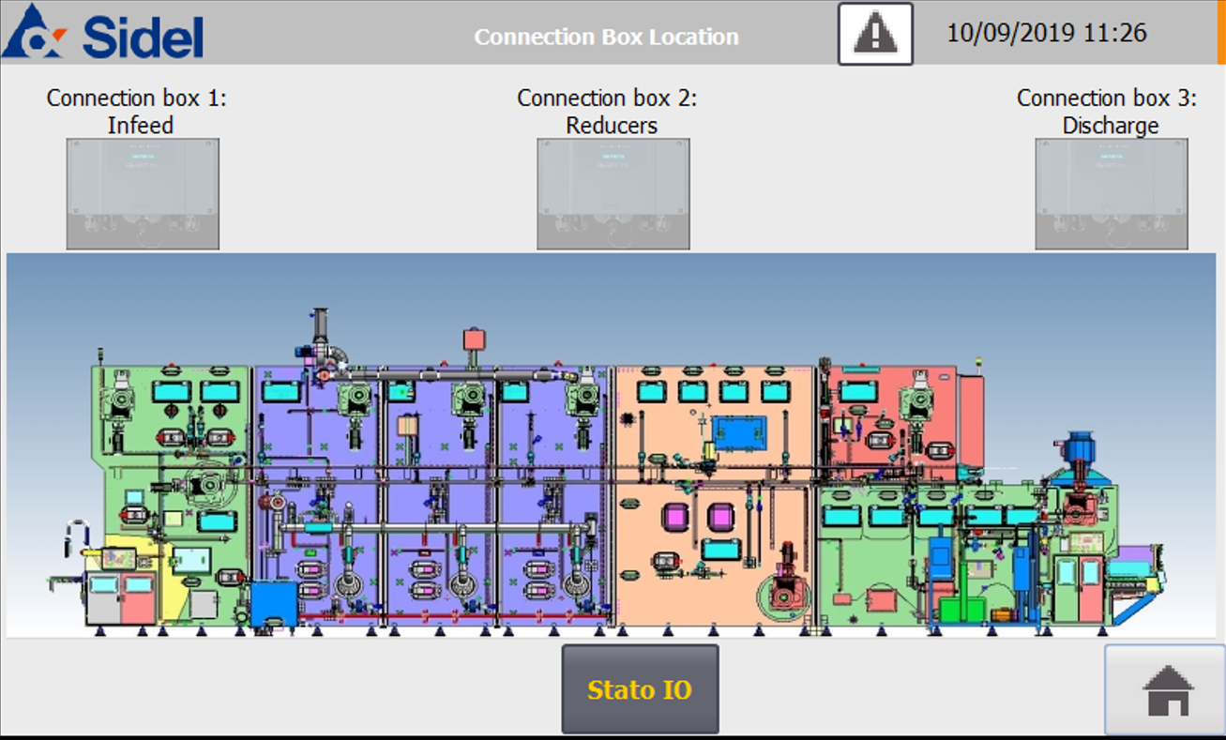
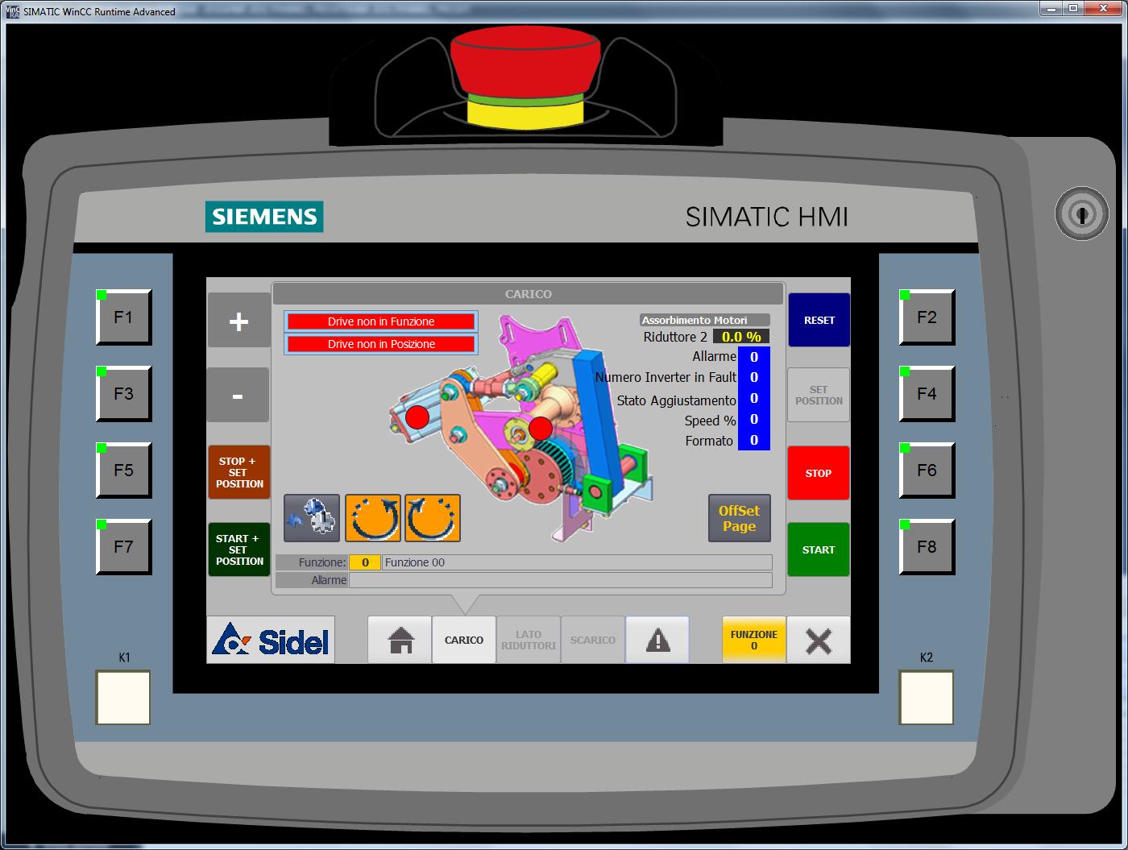
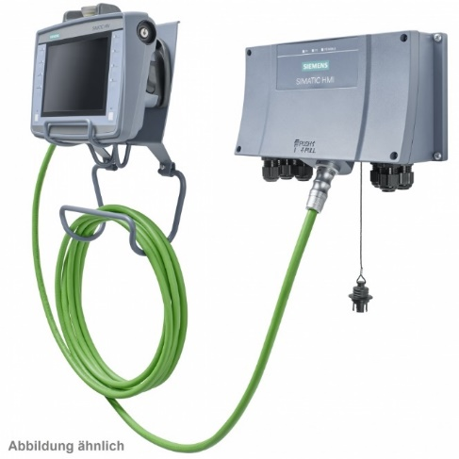
OPERATE YOUR BUSINESS SAFELY
Obsolescence
Safety & Ergonomics
Ref. VRB-056 – New Jog mobile panel
KEY FIGURES
Budget price:
BENEFITS
DESCRIPTION
25-35k€**
Improved safety ergonomics
Synchronization adjustment directly from the jog Panel
Alarm displaying and reset
Possibility to make diagnostic directly from the mobile panel
Touch panel for easy operation
Replace the old Jog push button with the new mobile panel
Add connection boxes in the critical point of the machine
Payback estimation:
Not applicable.
Installation time:
5 Man Days.*
Machine downtime:
2 days.*
*according to bottlewasher size and scope.
** Installation not included.
Can be combined with:
Upgrade to Movidrive C
HMI upgrade to windows 10
Machine application:
Sidel Bottlewashers

