Slide 1
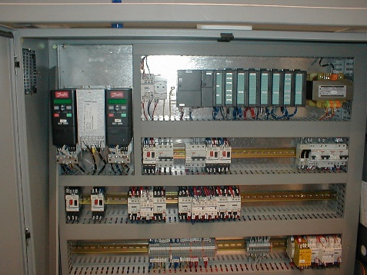
预计出现备件短缺
瓶坯定向器上的新CPU
价值和益处
描述
Safer solution with newer component available from Sidel.
Can prevent long downtimes in case of failure
  Risk of imminent Spare Parts unavailability.
  Risk of long production stoppages
The program (SW) is now installed on a removable memory card
  New kit components:
    CPU 312C
    Removable 64K EEPROM
    New program (SW)
    New input PLC card
BEFORE
AFTER
价值：更新换代
设备：Series2 吹瓶机
产品目录代码：OCB001

