Slide 1
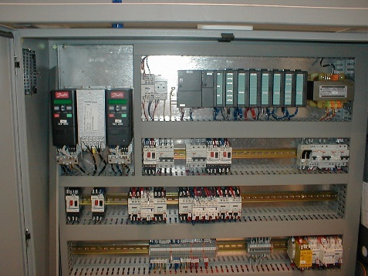
Anticipate spare parts shortage
New CPU on preform sorter
VALUE AND BENEFITS
DESCRIPTION
Safer solution with newer component available from Sidel.
Can prevent long downtimes in case of failure
  Risk of imminent Spare Parts unavailability.
  Risk of long production stoppages
The program (SW) is now installed on a removable memory card
  New kit components:
    CPU 312C
    Removable 64K EEPROM
    New program (SW)
    New input PLC card
BEFORE
AFTER
Value: Obsolescence
Equipment: Series2 blowers
Catalogue code: OCB001

