Slide 1
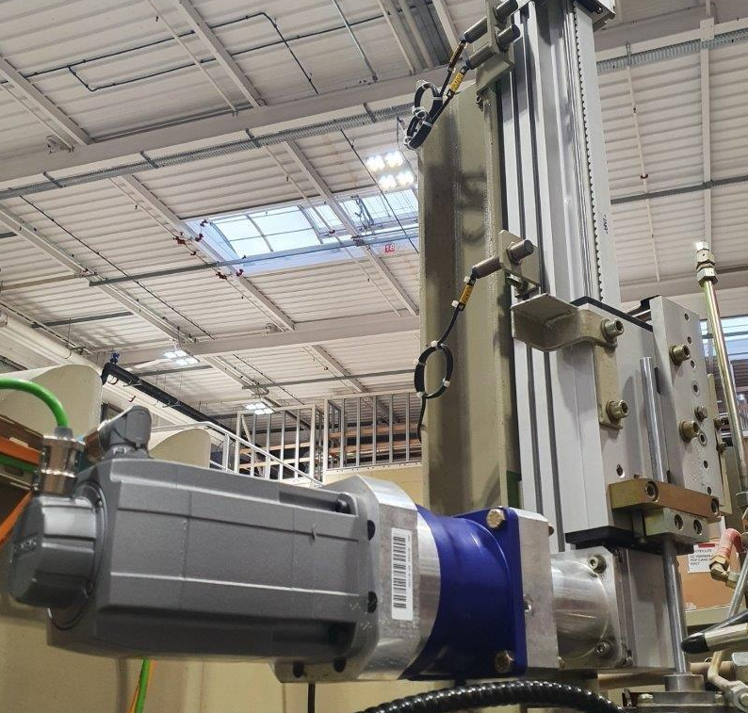
Anticipate spare parts shortage
New stretching motor for SBO 1LAB serie 1
VALUE AND BENEFITS
DESCRIPTION
solution with the latest components available, comes with a revamped HMI
prevent long downtimes in case of failure of the original stretching motor and its associated electronics
spare part unavailability.
long downtime for SBO 1LAB = loosing bottle development opportunities
New motor for the stretching unit
New drive
New PLC CPU
New touch screen
Value: Obsolescence
Equipment: Series 1 Blower - SBO 1LAB
Catalogue code: OCB002

