Slide 1



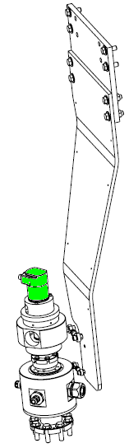
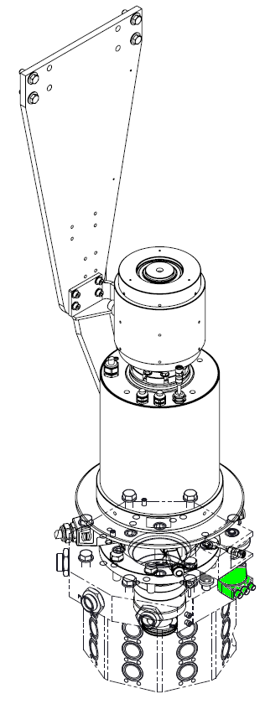
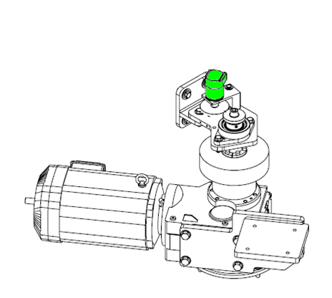
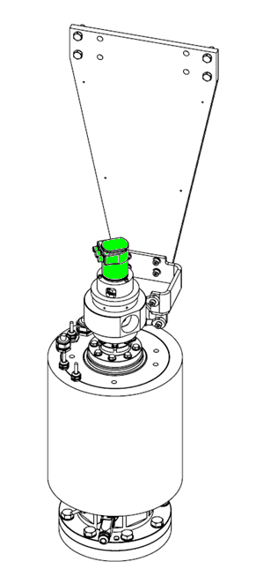

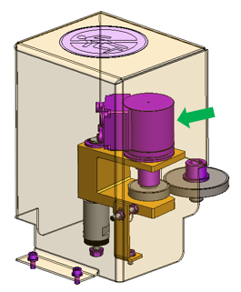
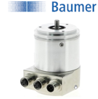
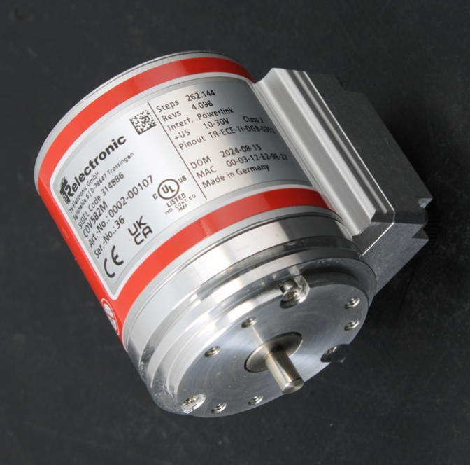
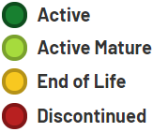
Secure your Matrix Blower uptime
Obsolescence
KEY FIGURES
O&U ref OCB004 - BAUMER Encoder obsolescence for Matrix
Budget price :
encoder location can be different upon
Matrix blower generation
5 k€
BENEFITS
Secure your production in case of failure
The BAUMER encoder for Matrix blower is now discontinued.
Anticipate risk of long downtime in case of failure and Spare Parts unavailability
Blower in combi configuration requires 2 encoders replacement,
one on main drive shaft and second on outfeed wheel shaft.
Encoder relocation upgrade #2061
is proposed as single solution
for early generation, including
encoder replacement, instead of
OCB004
Installation time :
2 days / 2 md*
Machine downtime :
1 day*
Lead time to deliver :
DESCRIPTION
10 weeks
    Replacement solution
    New ABSOLUTE CODER D06 L10 IP65 – TR Electronics
    No Spare Parts 1 to 1 , requires O&U with BOM update
* These data are not definitive, depending on your machine configuration.
✗
✓
before
Can be combined with:
HMI migration to W10
#2096
Contactless Electrical
Slip Ring #2099
Machine application:
after
Matrix Blower

