Slide 1






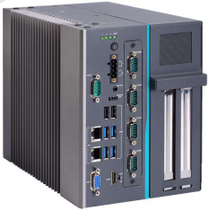
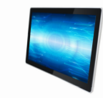
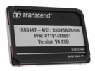

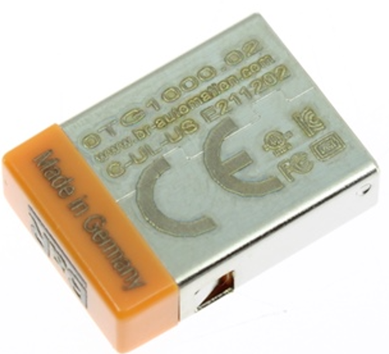

Matrix blower PC-HMI obsolescence
Obsolescence
O&U ref OCB006
Replacement of PCC 5P91-B&R APC-910i7 by PC IPC962HR-ES
Aseptic Equipment compliant
KEY FIGURES
Budget price :
26 k€
BENEFITS
before
✗
Payback estimation :
Prevent long downtimes in case of failure of Obsolete PCC / HMI,
as Original B&R PC is not available as Spare Parts anymore,
Cybersecurity features
faster operating hardware with higher Image quality and improved Heat Resistance
New PC compliant with Migration to Windows10 (O&U ref #2096)
Equipment lifecycle
Installation time:
2 MenDays **
Machine downtime:
1 day
Lead Time:
10 weeks
*according to equipment generation
or configuration.
** Installation not included in Budget price.
DESCRITPION
after
NEW PC
IPC962HR-ES
New PC ECRIN System IPC962HT-ES + adaptation kit (cables, …)
New Touch Screen FSM-22ALH, new Eprom + HDD + Memory card
Same OS/Win7 Licence as initial.
Note : does not include B&R obsolete CPUs replacement.
✓
Can be combined with:
Baumer encoder obsolescence or Relocation #OCB004 #2061
Can be replaced with:
W10 migration #2096
Machine application:
Matrix s/n 110 050 to 110396
s/n 210 050 to 210 063
s/n 120 032 to 120 172
s/n 220 025 to 220 031
s/n 130 002 to 130 020

