Slide 1
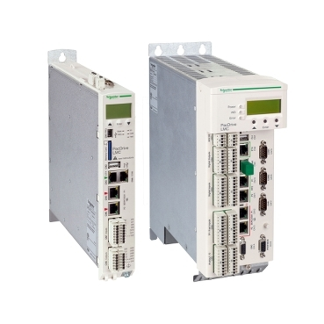
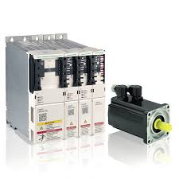
Anticipate spare parts shortage
ELAU LMC300 PACDRIVE 3
VALUE AND BENEFITS
DESCRIPTION
Safer solution with newer component available in the market.
Can prevent long downtimes in case of failure
  ELAU MAX-4/C 600/C 400 and MC-4 installed on Several Labeler production is stopped by manufacturer.
  Risk of imminent Spare Part unavailability.
  Risk of long Downtime for equipment at Bottlers prod plants.
Added Ethernet IP control feature to the Frequency converter (compared to the versions in which it was Devicenet for US market)
  New system with LMC300 PACDRIVE 3 :
    The new system consists of LMC300 PACDRIVE 3 controller with LXM62 servo driver.
    Works only with Elau SH motors that will be also included in the O&U in case needed (to replace obsolete SM model).
Value: Obsolescence
Equipment: Rollquattro
Catalogue code: OCL001

