Slide 1
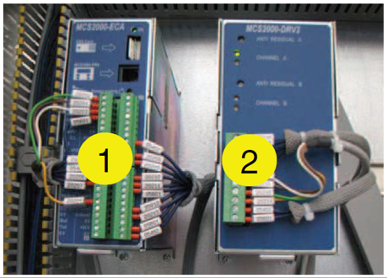
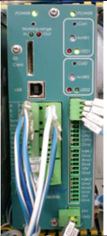
预计出现备件短缺
新华纳股
价值和益处
描述
Safer solution with newer component available from Sidel.
Can prevent long downtimes in case of failure
Utilization of Old type Warner MCS kit, used for braking management of the label reels, composed by “Logic unit” (1) and “Power unit” (2) installed on Rollquattro and Rollquattro Evo range of Labelers, is discontinued by OEM supplier.
Risk of imminent Spare Parts unavailability.
Risk of long Downtime for equipment at Bottlers prod plants.
Improvements Vs. old type
Smaller space required inside the cabinet
Spare Parts granted availability
New system with XCTRL-2DRV “all in one” Warner system:
The new system consists of a single unit by Warner.
It includes new installation retrofit kit, hardware and software modifications material.
It includes Sidel Automation engineer short intervention for installation and testing
Old Obsolete system
New single piece system
价值：更新换代
设备：Rollquattro
产品目录代码：OCL003

